Slide 1





UNIT-II
Embedded Hardware Design

Slide 2
EMBEDDED HARDWARE DESIGN: Analog and digital electronic components, I/O types and examples, Serial communication devices, Parallel device ports, Wireless devices, Timer and counting devices, Watchdog timer, Real time clock.

Slide 3
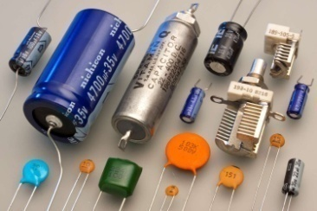

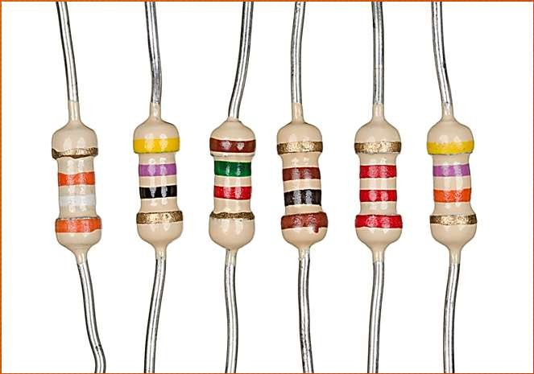
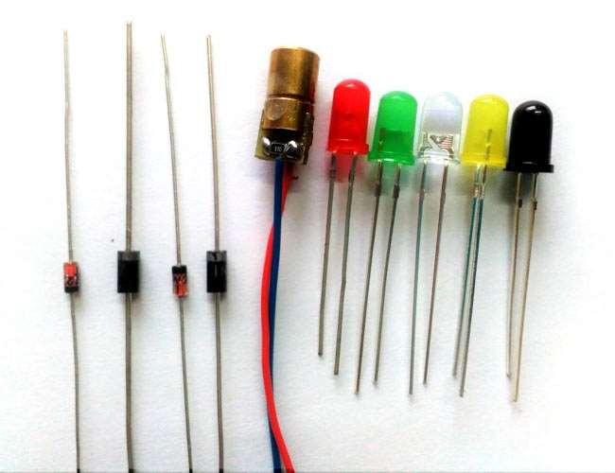
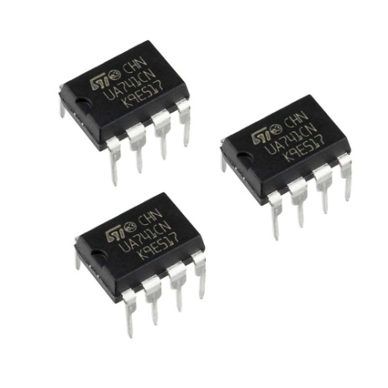
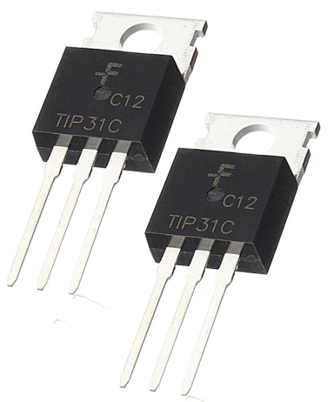
Analog Electronic Components
Resistors, capacitors, diodes, inductors, operational amplifiers (OpAmps), transistors, etc. are the commonly used analog electronic components in embedded hardware design.

Slide 4
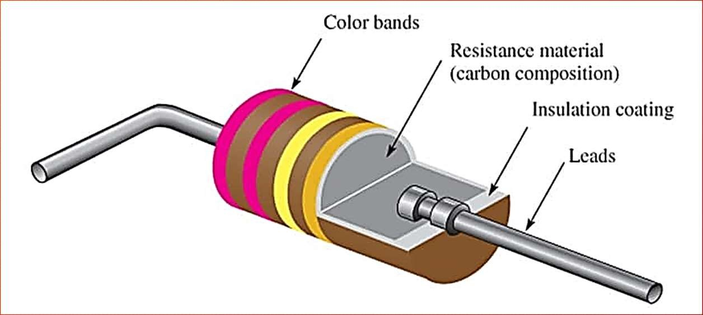
Resistors
A resistor limits the current flowing through a circuit.
Interfacing of LEDs, buzzer, etc. with the
port pins of microcontroller through
typical
current limiting resistors is a
example for the usage of resistors in embedded application.

Slide 5

Capacitors & Inductors
Capacitors and inductors are used in signal filtering and resonating circuits.
Reset circuit implementation, matching circuits for RF designs, power supply decoupling, etc. are examples for the usage of capacitors in embedded hardware circuit.
Electrolytic capacitors, ceramic capacitors, tantalum capacitors, etc. are the commonly used capacitors in embedded hardware design.
Inductors are widely used for filtering the power supply from ripples and noise signals.
Inductors with inductance value in the microhenry ( ) range are commonly used in embedded applications for filter and matching circuit implementation.

Slide 6
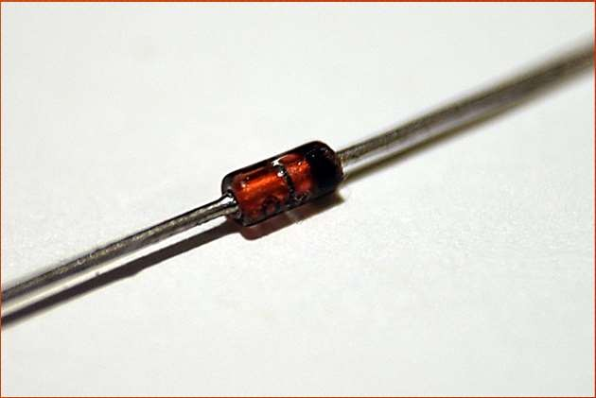
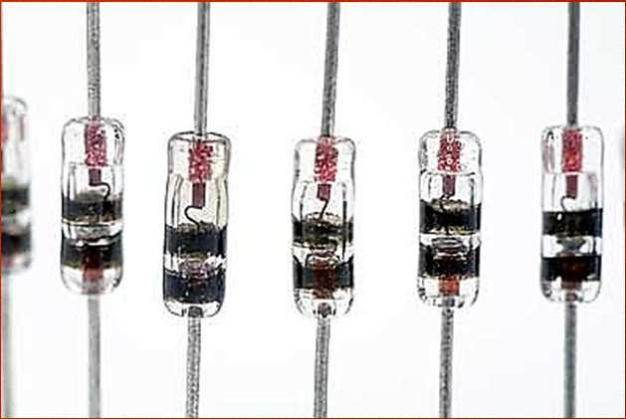
Diodes
P-N Junction diode, Schottky diode, Zener diode, etc. are the commonly used diodes in Embedded Hardware circuits.
A schottky diode is same as a P-N Junction diode except that its forward voltage drop (voltage drop across diode when conducting) is very low (of the order of 0.15V to 0.45) when compared to ordinary P-N junction diode (of the order of 0.7V to 1.7V).
Also the current switching time of Schottky diode is very small compared to the ordinary P-N junction diode.

Slide 7
Diodes(Cont.)
A Zener diode acts as normal P-N junction diode when forward biased. It also permits current flow in the reverse direction, if the voltage is greater than the junction breakdown voltage.
It is normally used for voltage clamping applications.
Reverse polarity protection, voltage rectification (AC-DC converters), freewheeling of current produced in inductive circuits, clamping of voltages to a desired level (e.g., Brown- out protection circuit implementation using zener diode), etc. are examples for the usage of diodes in embedded applications.

Slide 8
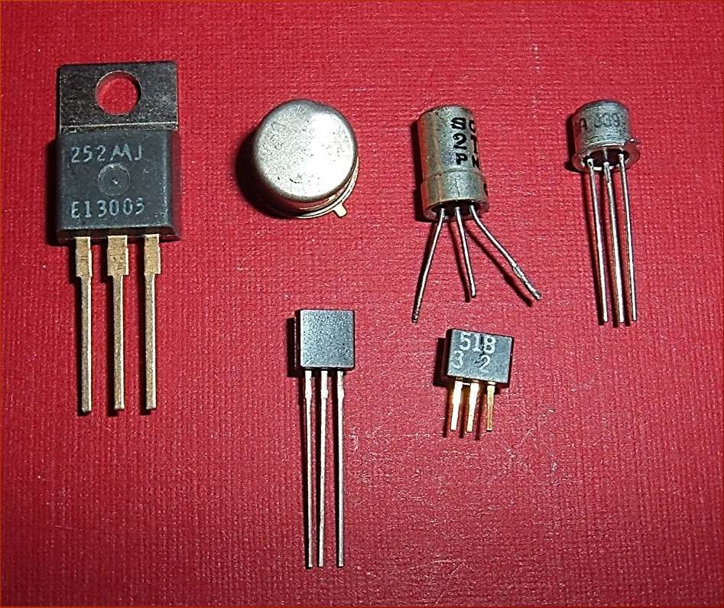
Transistors
Transistors in embedded applications are used for either switching or amplification purpose.
In switching application, the transistor is in either ON or OFF state.
In amplification operation, the transistor is always in the ON state (partially ON).
The common emitter configuration of NPN transistor is widely used in switching and driving circuits in embedded applications.
Relay, buzzer and stepper motor driving circuits are examples for common emitter configuration based driver circuit implementation using transistor.

Slide 9
Digital Electronic Components
Digital electronics deal with digital or discrete signals. Microprocessors, microcontrollers and system on chips (SoCs) work on digital principles.
Embedded systems employ various digital electronic circuits for ‘Glue logic’ implementation.
‘Glue logic’ is the custom digital electronic circuitry required to achieve compatible interface between two different integrated circuit chips.
Address decoders, latches, encoders/decoders, etc. are examples for glue logic circuits.
Transistor Transistor Logic (TTL), Complementary Metal Oxide Semiconductor (CMOS) logic etc. are some of the standards describing the electrical characteristics of digital signals in a digital system.

Slide 10
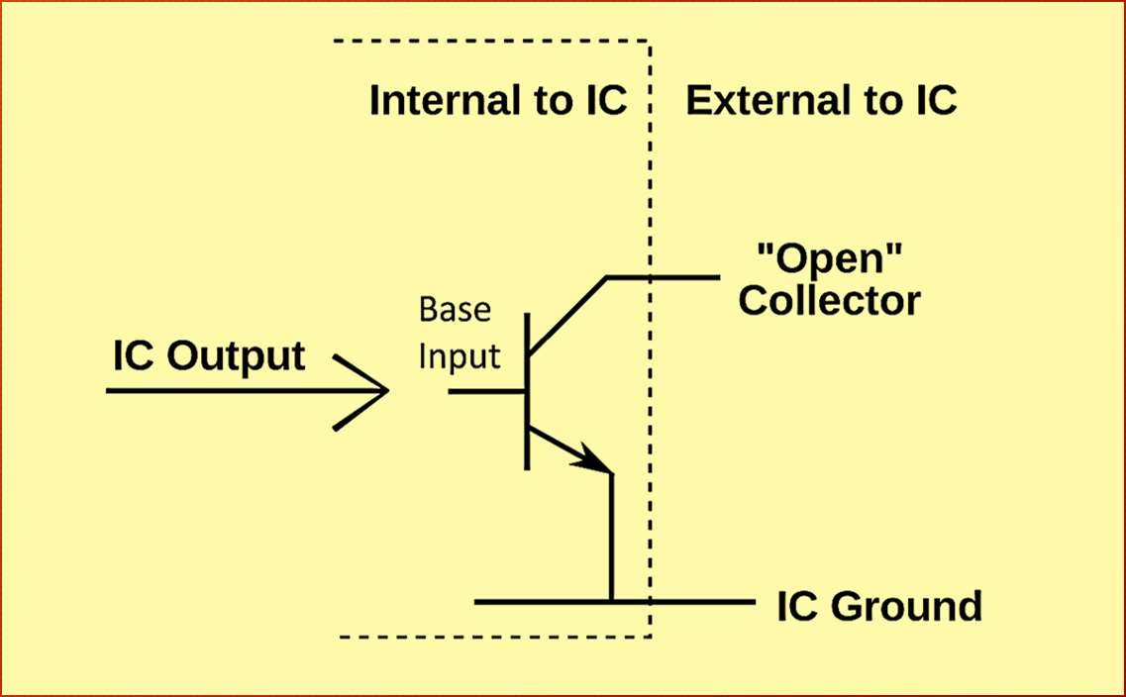
Open Collector and Tri-State Output
Open collector is an I/O interface standard in digital system design and a common type of output found on many Integrated Circuit (IC) chip which behaves like a switch that is either connected to ground or disconnected.
Instead of outputting a signal of a specific voltage or current, the output signal is applied to the base of an internal NPN transistor whose collector is externalized (open) on a pin of the IC.
The emitter of the transistor is connected internally to the ground pin.
Diagram illustrates an open collector output configuration.

Slide 11
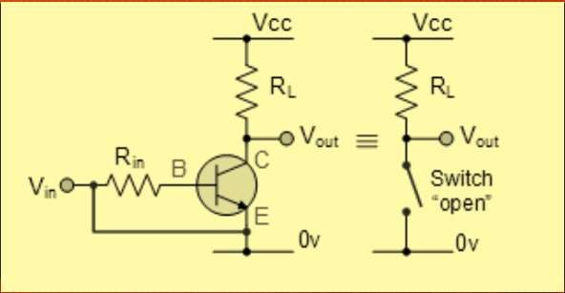
Open Collector (Cont.)
For the output pin to function properly, the output pin should be pulled, to the desired voltage for the o/p device,
through a pull-up resistor.
The output signal of the IC is fed to the base of an open collector transistor.
When the base drive to the transistor is ON and the collector is in open state, the o/p pin floats.
This state is also known as ‘high impedance’ state. Here the output is neither driven to logic ‘high’ nor logic ‘low’.
If a pull-up resistor is connected to the o/p pin, when the base drive is ON, the o/p pin becomes at
logic 0 (0 V). With a pull-up resistor, if the base driver is 0, the o/p will be at logic high (Voltage = 𝑉𝑐𝑐).

Slide 12
Open Collector (Cont.)
The advantages of open collector output in embedded system design are listed below:
It facilitates the interfacing of devices, operating at a voltage different from the IC, with the IC. Thereby, it eliminates the need for additional interface circuits for connecting devices at different voltage levels.
An open collector configuration supports multi-drop connection, i.e., connecting more than one open collector communication interfaces like I2C, 1-Wire, etc. Please refer to the various interfaces described in Chapter 2 under the section ‘Onboard Communication Interfaces’.
it is easy to build ‘Wired AND’ and ‘Wired OR’ configuration using open collector output lines.

Slide 13
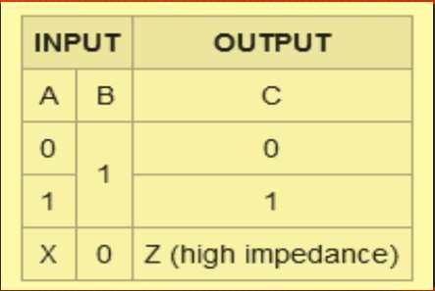
Tri-State Output
The output of a standard logic device has two states, namely ‘Logic 0 (LOW)’ and ‘Logic 1 (HIGH)’ whereas tri-state devices have three states for the output, namely, ‘Logic 0 (LOW)’, ‘Logic 1 (HIGH)’, and the ‘High Impedance (FLOAT)’.
A tri-state logic device contains a device activation line called ‘Device Enable’.
When the ‘Device Enable’ line is activated (set at ‘Logic 1’ for an active ‘HIGH’ enable input and at ‘Logic 0’ for an active ‘LOW’ enable input), the device acts like a normal logic device and the output will be in any one of the logic conditions, ‘Logic 0 (LOW)’ or ‘Logic 1 (HIGH)’.
When the ‘Device Enable’ line is de-activated (set at ‘Logic 0’ for an active ‘HIGH’ enable input and at ‘Logic 1’ for an active ‘LOW’ enable input), the output of the logic device enters in a high impedance state and the device is said to be in the floating state.

Slide 14
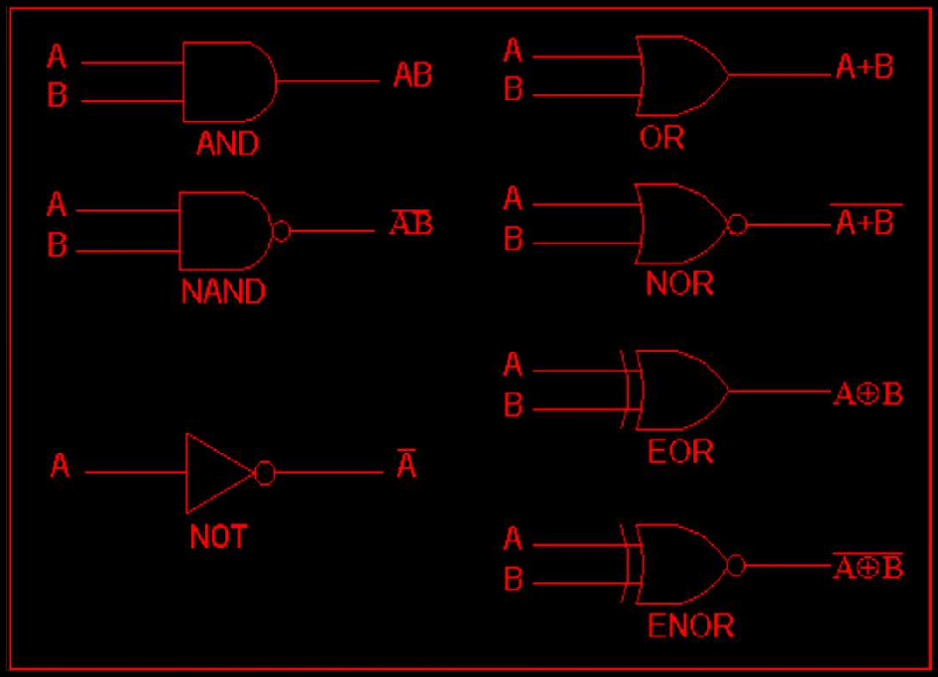
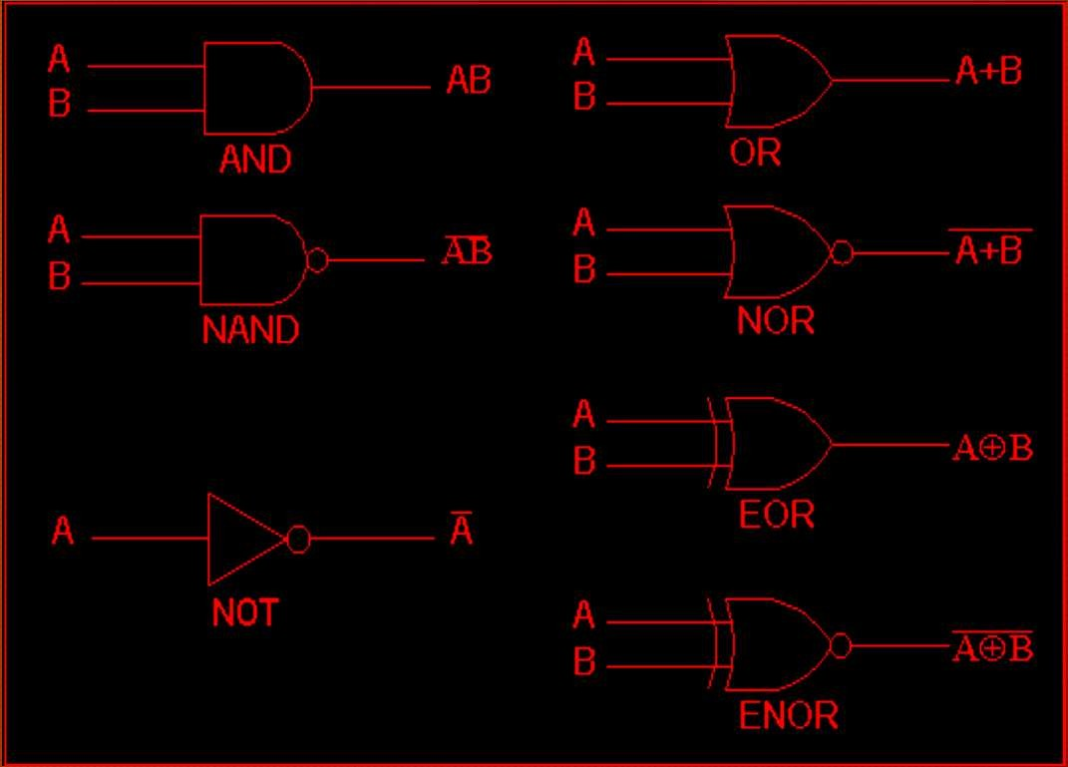
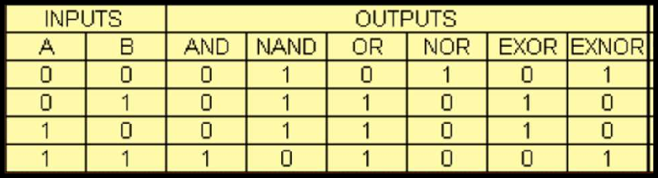
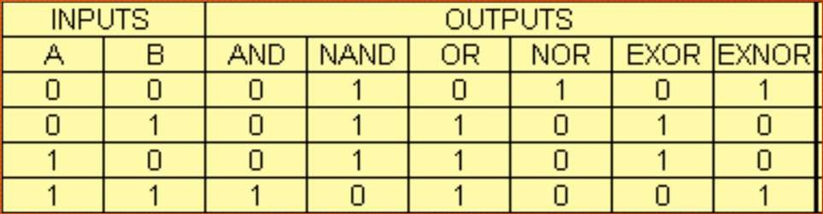
Logic Gates
Logic gates are the building blocks of digital circuits. Logic gates control the flow of digital information by performing a logical operation of the input signals.
Depending on the logical operation, the logic gates used in digital design are classified into-AND, OR, XOR, NOT, NAND, NOR and XNOR.
The logical relationship between the output signal and the input signals for a logic gate is represented
using a truth table.
Diagram illustrates the truth table and symbolic representation of each logic gate.

Slide 15
I/O Port Types with Examples
Port - A port is a device
to receive the bytes from external peripheral(s) [or device(s) or processor(s) or controllers] for reading them, later using instructions executed on the processor or
to send the bytes to external peripheral or device or processor using instructions executed on processor.
A Port connects to the processor using address decoder and system buses.
The processor uses the addresses of the port-registers for programming the port functions or modes, reading port status and for writing or reading bytes.

Slide 16
Port (examples)
SI serial interface in 8051
SPI serial peripheral interface in 68HC11
PPI parallel peripheral interface 8255
Ports P0, P1, P2 and P3 in 8051 or PA, PB,
PC and PD in 68HC11
COM1 and COM2 ports in an IBM PC

Slide 17
I/O Port Types
Types of Serial ports
Synchronous Serial Input
Synchronous Serial Output
Asynchronous Serial UART input
Asynchronous Serial UART output
Types of parallel ports
Parallel Port One Bit Input
Parallel Port One bit Output
Parallel Port Multi-bit Input
Parallel Port Multi-bit Output

Slide 18
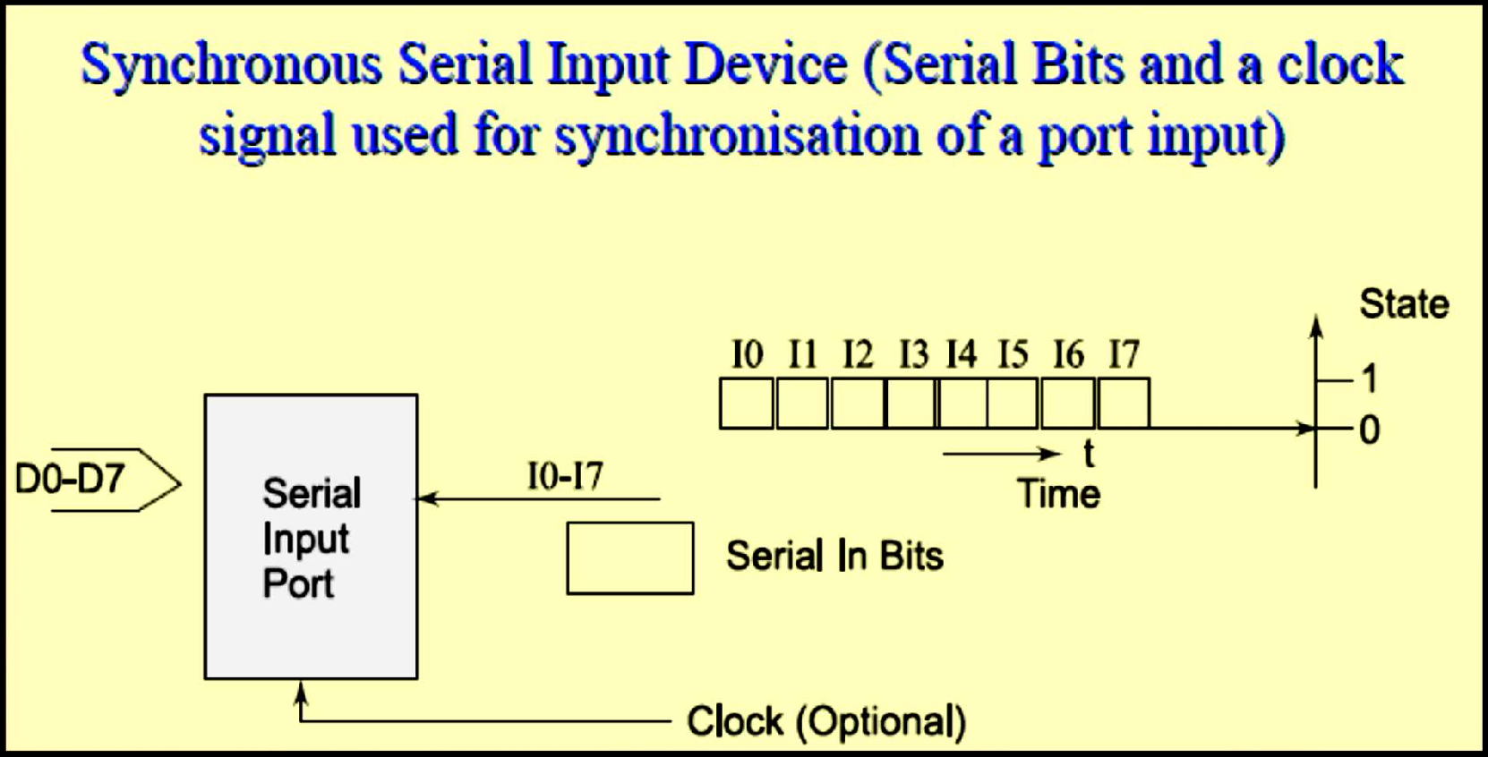

Synchronous Serial Input

Slide 19
Synchronous Serial Input
The sender along with the serial bits also sends the clock pulses SCLK (serial clock) to the receiver port pin. The port synchronizes the serial data input bits with clock bits. Each bit in each byte as well as each byte in synchronization.
Synchronization means separation by a constant interval or phase difference. If clock period = T, then each byte at the port is received at input in period = 8T.
The bytes are received at constant rates. Each byte at input port separates by 8T and data transfer rate for the serial line bits is (1/T) bps. [1bps = 1 bit per s]

Slide 20
Serial data and clock pulse-inputs
On same input line - when clock pulses either encode or modulate serial data input bits suitably. Receiver detects the clock pulses and receives data bits after decoding or demodulating.
On separate input line - When a separate SCLK input is sent, the receiver detects at the middle or + ve edge or –ve edge of the clock pulses that whether the data- input is 1 or 0 and saves the bits in an 8-bit shift register. The processing element at the port (peripheral) saves the byte at a port register from where the microprocessor reads the byte.

Slide 21
Master output slave input (MOSI) and Master input slave output (MISO)
MOSI when the SCLK is sent from the sender to the receiver and slave is forced to synchronize sent inputs from the master as per the inputs from master clock.
MISO when the SCLK is sent to the sender (slave) from the receiver (master) and slave is forced to synchronize for sending the inputs to master as per the master clock outputs.
Synchronous serial input is used for inter-processor transfers, audio inputs and streaming data inputs.

Slide 22
Chat Question #5
Name any TWO on-board communication interfacing devices?

Slide 23
Synchronous Serial Input Example
Inter-processor Data Transfer
Reading from CD Or Hard Disk
Audio Input, Video Input, Dial Tone, Network Input
Transceiver Input,
Scanner Input
Remote Controller Input
Serial I/O Bus Input
Writing to Flash Memory Using SDIO (Secure Data Association I/O Based Card)

Slide 24
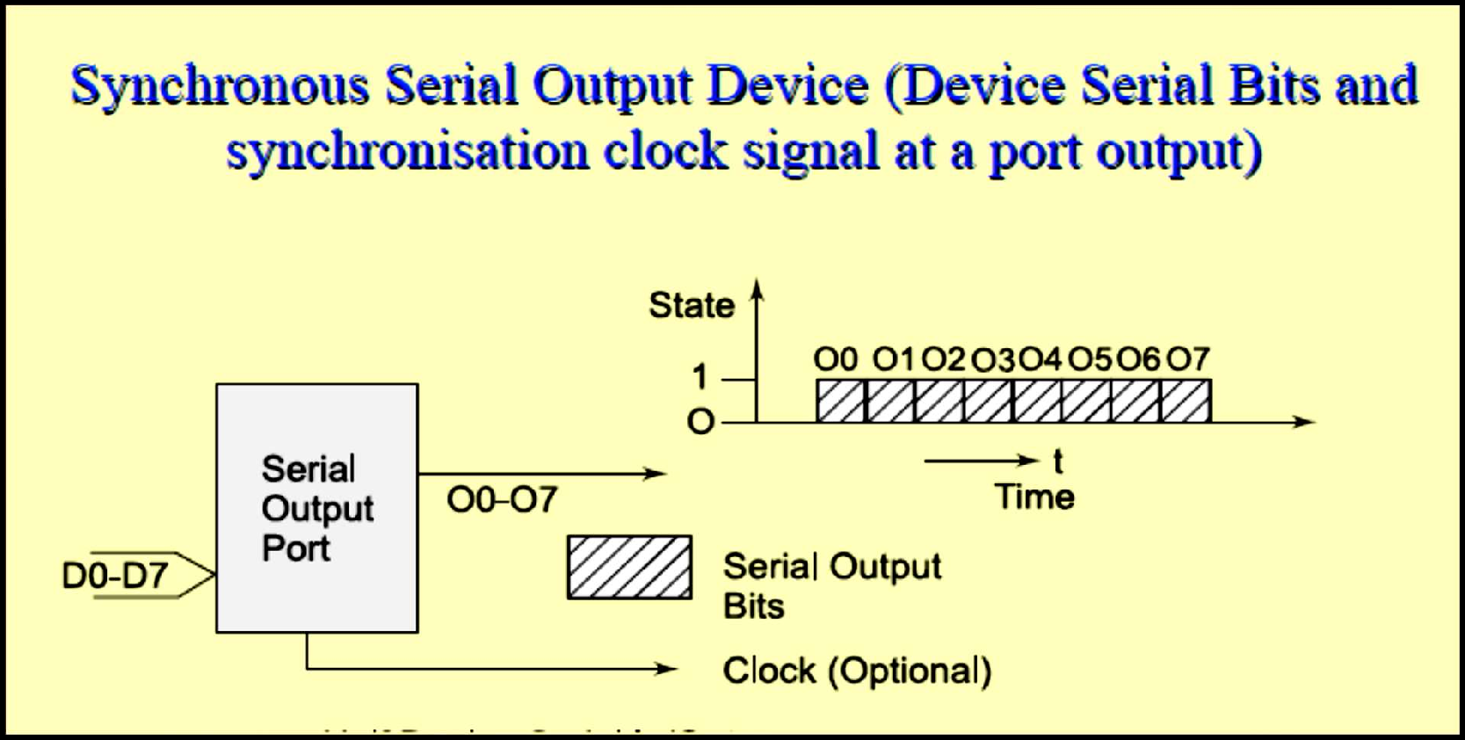
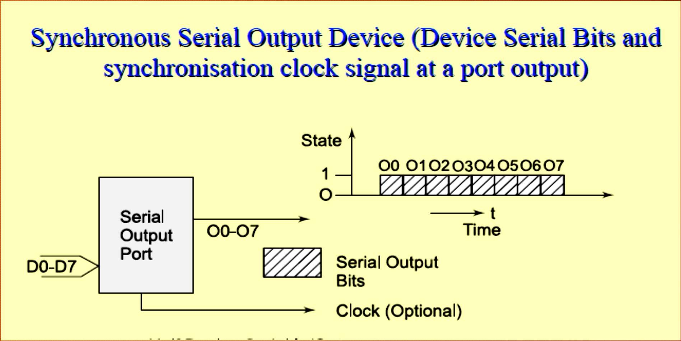
Synchronous Serial Output

Slide 25
Synchronous Serial Output
Each bit in each byte sent in synchronization with a clock.
Bytes sent at constant rates. If clock period = T, then data transfer rate is (1/T) bps.
Sender either sends the clock pulses at SCLK pin or sends the serial data output and clock pulse-input through same output line with clock pulses either suitably modulate or encode the serial output bits.

Slide 26
Synchronous serial output using shift register
The processing element at the port (peripheral) sends the byte through a shift register at the port to where the microprocessor writes the byte.
Synchronous serial output is used for interprocessor transfers, audio outputs and streaming data outputs.

Slide 27
Chat Question #6
Name any TWO Product-level communication interfacing devices?

Slide 28
Synchronous Serial Output example
Inter-processor Data Transfer
Multiprocessor Communication
Writing To CD Or Hard Disk
Audio Input / Output
Video Input / Output
Dialer Output
Network Device Output
Remote TV Control
Transceiver Output and Serial I/O Bus Output or Writing to Flash Memory Using SDIO

Slide 29
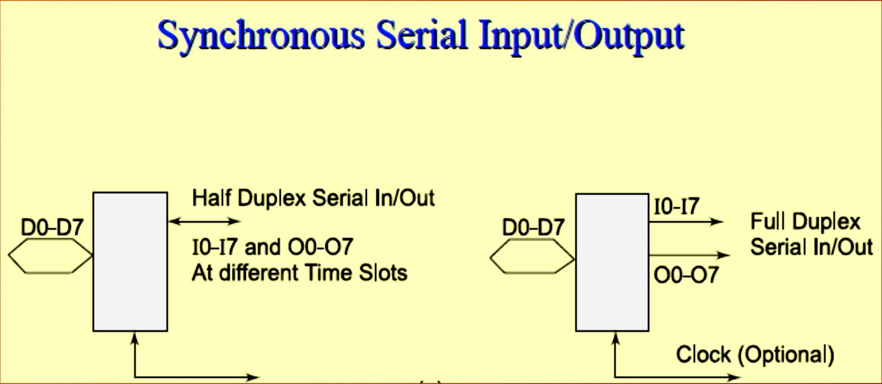
Synchronous Serial Input / Output

Slide 30
Synchronous Serial Input / Output
Each bit in each byte is in synchronization at input and each bit in each byte is in synchronization at output with the master clock output .
The bytes are sent or received at constant rates. The I/O’s can also be on same I/O line when input/output clock pulses either suitably modulate or encode the serial input/output, respectively. If clock period = T, then data transfer rate is (1/T) bps.
The processing element at the port (peripheral) sends and receives the byte at a port register to or from where the microprocessor writes or reads the byte.

Slide 31
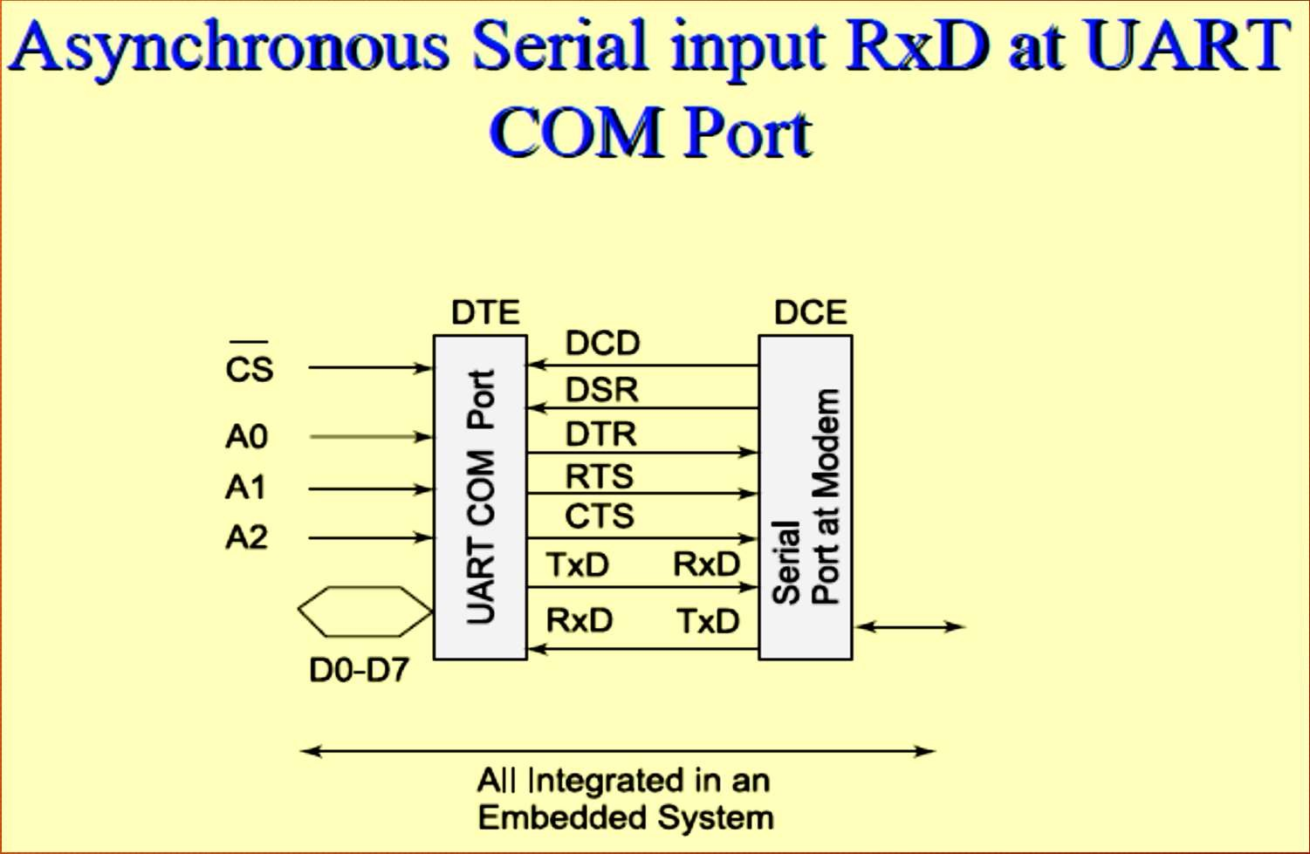
Asynchronous Serial port line RxD (receive data)

Slide 32
Asynchronous Serial port line RxD (receive data)
Does not receive the clock pulses or clock information along with the bits.
Each bit is received in each byte at fixed intervals but each received byte is not in synchronization.
Bytes separate by the variable intervals or phase differences
Asynchronous serial input also called UART input if serial input is according to UART protocol

Slide 33
Example Serial Asynchronous Input
Asynchronous serial input is used for keypad inputs and modem inputs in computers.
Keypad controller serial data-in
Mice
Keyboard controller
modem input
character send inputs on serial line [also called UART (universal receiver and transmitter) input when according to UART mode]

Slide 34
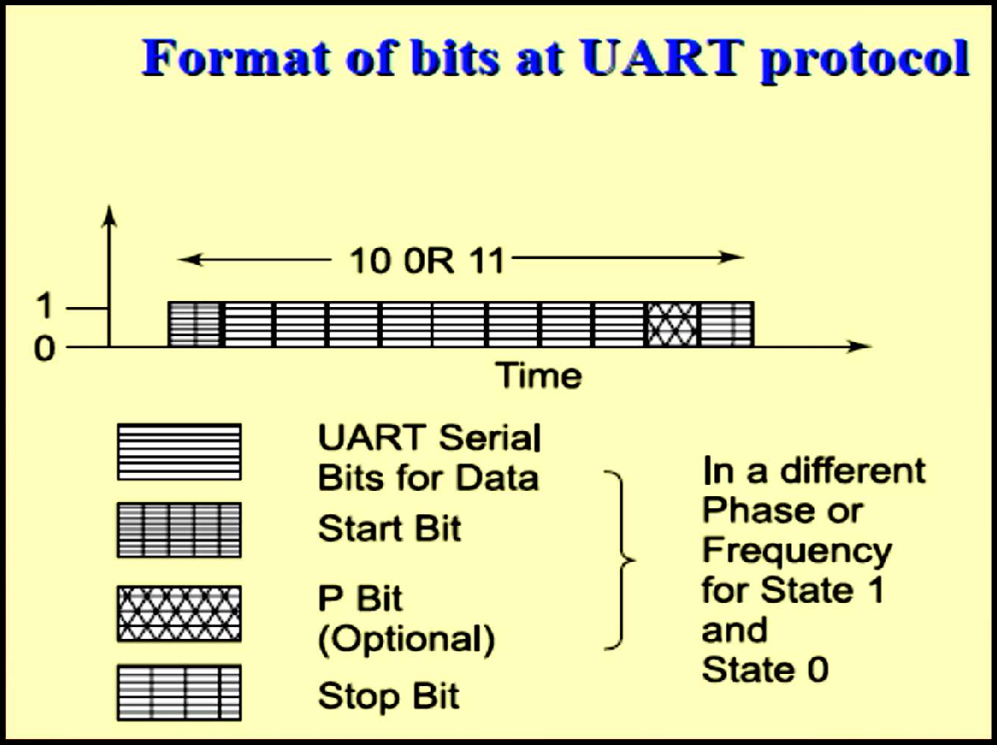
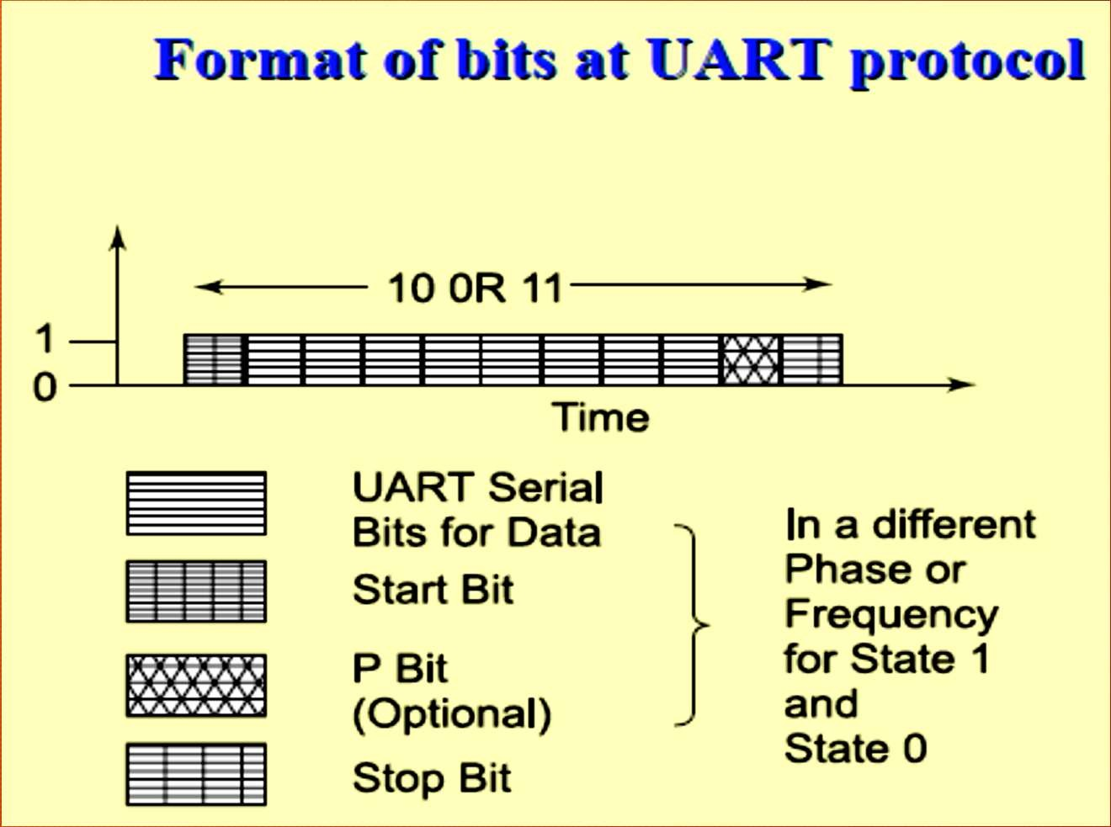
Format of bits at UART Protocol

Slide 35
UART protocol serial line format
Starting point of receiving the bits for each byte is indicated by a line transition from 1 to 0 for a period = T. [T⁻¹ called baud rate.]
If sender’s shift-clock period = T, then a byte at the port is received at input in period = 10.T or 11.T due to use of additional bits at start and end of each byte.

Slide 36
UART protocol serial line format
Receiver detects n bits at the intervals of T from the middle of the start indicating bit. The n = 0, 1, …, 10 or 11 and finds whether the data-input is 1 or 0 and saves the bits in an 8-bit shift register.
Processing element at the port (peripheral) saves the byte at a port register from where the microprocessor reads the byte.

Slide 37
Asynchronous Serial Output
Asynchronous output serial port line TxD (transmit data).
Each bit in each byte transmit at fixed intervals but each output byte is not in synchronization (separates by a variable interval or phase difference).
Minimum separation is 1 stop bit interval

Slide 38
TxD
Does not send the clock pulses along with the bits.
Sender transmits the bytes at the minimum intervals of n.T. Bits receiving starts
from the middle of the start indicating bit, n = 0, 1, …, 10 or 11 and sender sends the bits through a 10 or 11 -bit shift register.
The processing element at the port (peripheral) sends the byte at a port register to where the microprocessor is to write the byte.
Synchronous serial output is also called UART output if serial output is according to UART protocol

Slide 39
Example Serial Asynchronous Output
Output from modem
output for printer
The output on a serial line [also according to UART]
called UART output when

Slide 40
Half Duplex & Full-Duplex
Half duplex means as follows: at an instant communication can only be one way (input or output) on a bi-directional line.
An example of half-duplex mode ─ telephone communication.
On one telephone line, the talk can only in the half-duplex way mode.
Full duplex means that at an instant, the communication can be both ways.
An example of the full duplex asynchronous mode of communication is the communication between the modem and the computer though TxD and RxD lines or communication using
SI in modes 1, 2 and 3 in 8051

Slide 41
Parallel Port single bit input
Completion of a revolution of a wheel
Achieving preset pressure in a boiler
Exceeding the upper limit of permitted weight over the pan of an electronic balance
Presence of a magnetic piece in the vicinity of or within reach of a robot arm to its end point and Filling of a liquid up to a fixed level.

Slide 42
Parallel Port Output- single bit
PWM output for a DAC, which controls liquid level, or temperature, or pressure, or speed or angular position of a rotating shaft or a linear displacement of an object or a d.c. motor control
Pulses to an external circuit
Control signal to an external circuit

Slide 43
Chat Question #7
Name any TWO Parallel I/O communication interfacing devices?

Slide 44
Parallel Port Input & Output- multi-bit
ADC input from liquid level measuring sensor or temperature sensor or pressure sensor or speed sensor or d.c. motor rpm sensor
Encoder inputs for bits for angular position of a rotating shaft or a linear displacement of an object
LCD controller for Multilane LCD display matrix unit in a cellular phone to display on the screen the phone number, time, messages, character outputs or pictogram bit-images for display screen or e-mail or web page.
Print controller output
Stepper-motor coil driving bits

Slide 45
Parallel Port Input-Output
PPI 8255
Touch screen in mobile phone

Slide 46
Chat Question #8
Name any TWO serial & Parallel ports?

Slide 47
Ports or Devices Communication and communication protocols
Two Modes of communication between the devices and computer system
Full Duplex – Both devices or device and computer system simultaneously communicate each other.
Half Duplex – Only one device can communicate with another at an instance
Three ways of communication between the ports or devices
Synchronous
Iso-synchronous
Asynchronous

Slide 48
1. Synchronous and Iso-synchronous Communication
Synchronous Communication- When a byte (character) or a frame (a collection of bytes) of the data is received or transmitted at the constant time intervals with uniform phase differences, the communication is called as synchronous.
Bits of a full frame are sent in a prefixed maximum time interval.
Iso-synchronous- Synchronous communication special case- when bits of a full frame are sent in the maximum time interval, which can be variable.

Slide 49
Synchronous Communication
Clock information is transmitted explicitly or implicitly in synchronous communication.
The receiver clock continuously maintains constant phase difference with the transmitter clock.
Bits of a data frame maintain uniform phase difference and are sent within a fixed maximum time interval.

Slide 50
Example of synchronous serial communication
Frames sent over a LAN.
Frames of data communicate with the constant time intervals between each frame remaining constant.
Another example is the inter-processor communication in a multiprocessor system

Slide 51
Optional Synchronous Code bits
Optional Sync Code bits or bi-sync code bits or frame start and end signaling bits─ During communication few bits (each separated by interval ΔT) sent as Sync code to enable the frame synchronization or frame start signaling.
Code bits precede the data bits.
May be inversion of code bits after each frame in certain protocols.
Flag bits at start and end are also used in certain protocols.

Slide 52
Always présent Synchronous device port data bits
Reciprocal of T is the bit per second(bps).
Data bits─ m frame bits or 8 bits transmit such that each bit is at the line for time ΔT or, each frame is at the line for time (m. T)m may be 8 or a large number.
It depends on the protocol Synchronous device clock bits
Clock bits ─ Either on a separate clock line or on data line such that the clock information is also embedded with the data bits by an appropriate encoding or modulation
Generally not optional

Slide 53
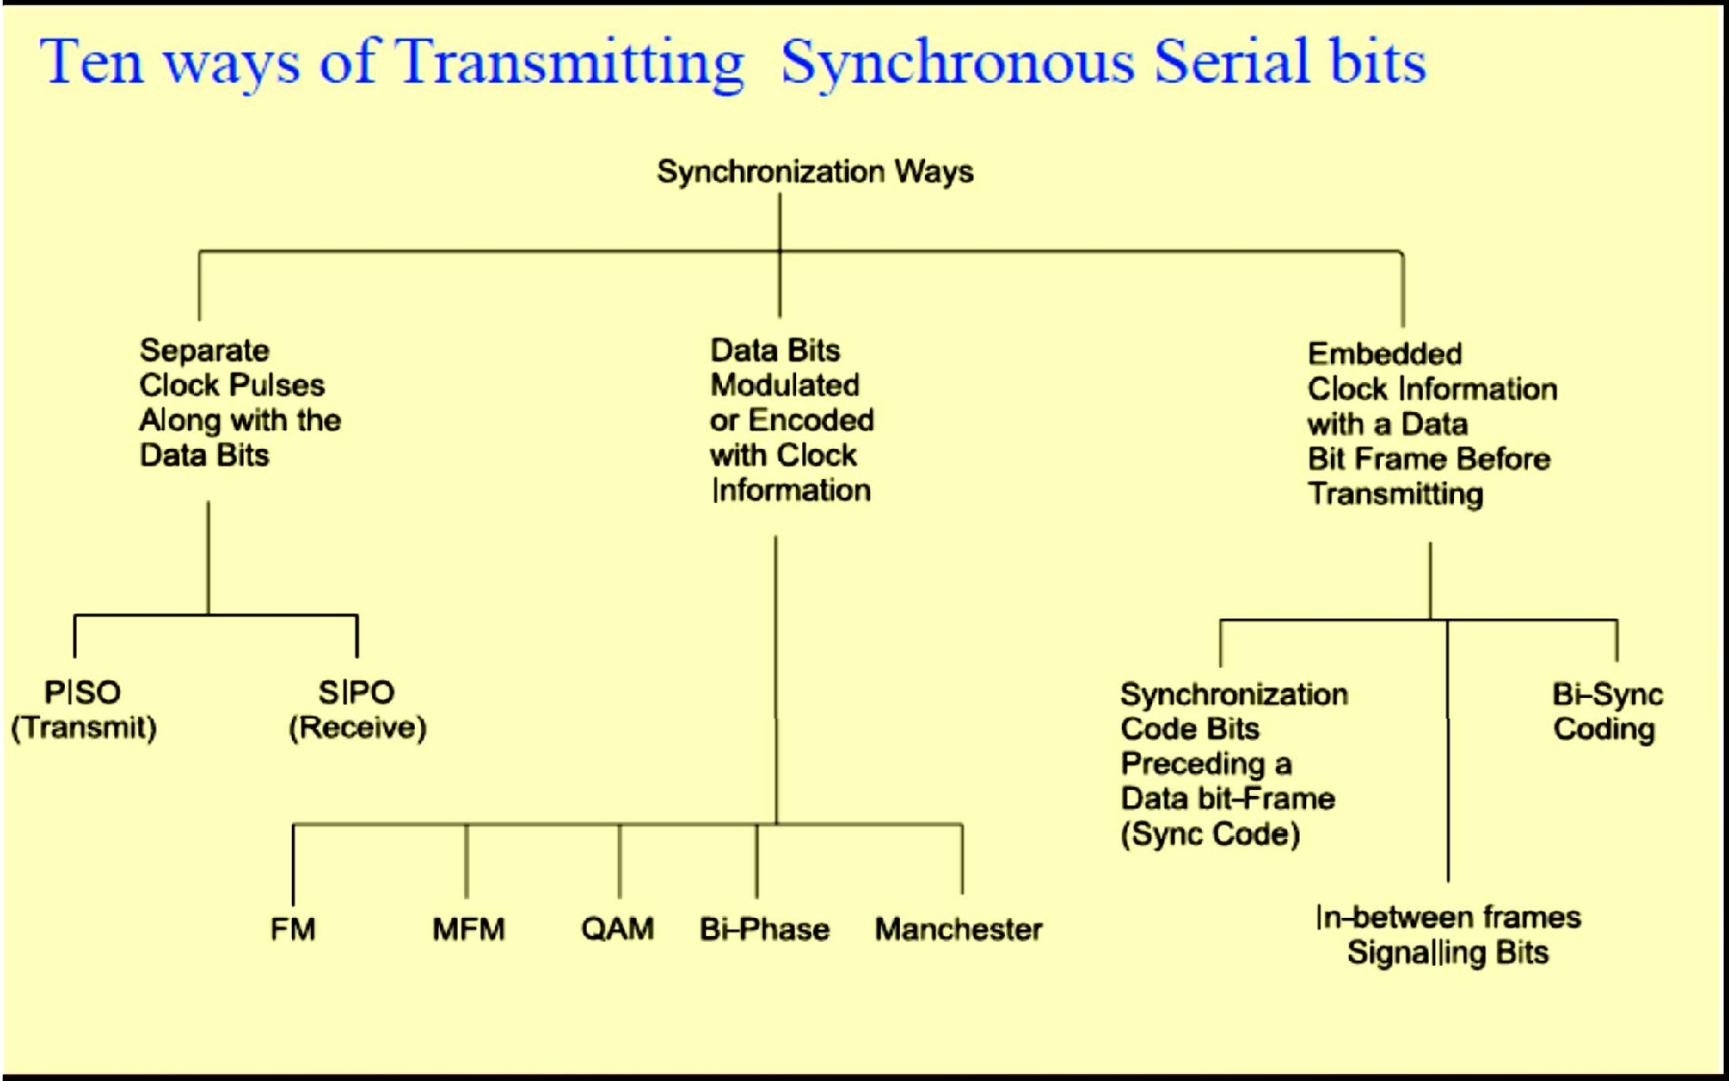
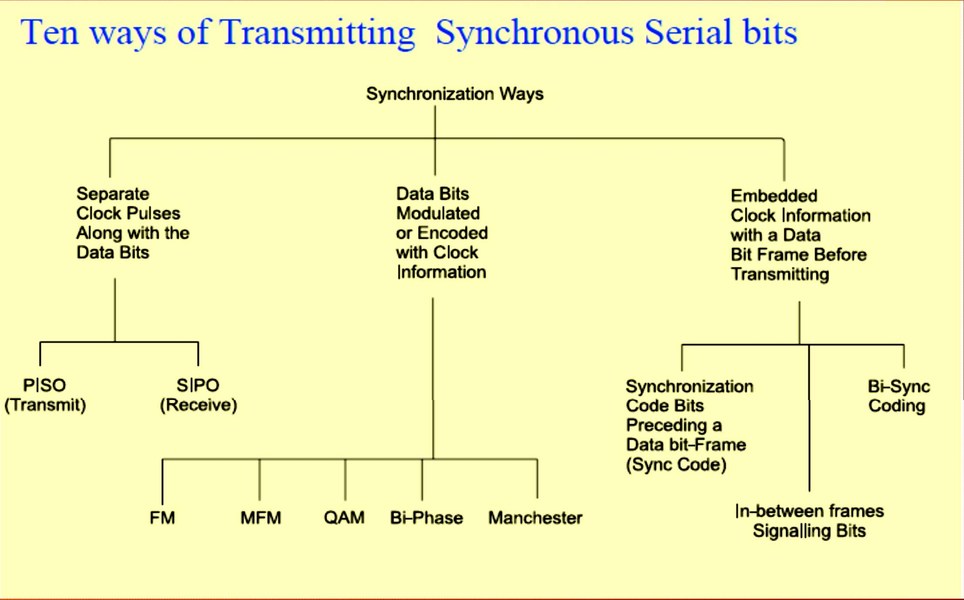


Slide 54
Synchronous Communication
First characteristics of synchronous communication
Bytes (or frames) maintain a constant phase difference, which means they are synchronous, i.e. in synchronization.
No permission of sending either the bytes or the frames at the random time intervals, this mode therefore does not provide for handshaking during the communication interval ─ This facilitates fast data communication at pre-fixed bps.
Second characteristics of synchronous communication
A clock ticking at a certain rate has always to be there for transmitting serially the bits of all the bytes (or frames) serially. Mostly, the clock is not always implicit to the synchronous data receiver.
The transmitter generally transmits the clock rate information

Slide 55
2. Asynchronous Communication from Serial Ports or Devices
Asynchronous Communication-
Clocks of the receiver and transmitter independent, unsynchronized, but of same frequency and variable phase differences between bytes or bits of two data frames, which may not be sent within any prefixed time interval.
Example of asynchronous communication-
UART Serial,
Telephone or modem communication.
RS232C communication between the UART devices
Each successive byte can have variable time-gap but have a minimum in-between interval and no maximum limit for full frame of many bytes

Slide 56
Two characteristics of asynchronous communication
Bytes (or frames) need not maintain a constant phase difference and are asynchronous, i.e., not in synchronization. There is permission to send either bytes or frames at variable time intervals─ This facilitates in- between handshaking between the serial transmitter port and serial receiver port.
Though the clock must ticking at a certain rate always has to be there to transmit the bits of a single byte (or frame) serially, it is always implicit to the asynchronous data receiver and is independent of the transmitter

Slide 57
Example: IBM personal computer has two COM ports (communication ports)
COM1 and COM2 at IO addresses 0x2F8-0xFF and 0xx38-0x3FF
Handshaking signals─ RI, DCD, DSR, DTR, RTS, CTS, DTR
Data Bits─ RxD and TxD

Slide 58
Example: COM port and Modem Handshaking signals
After DTR, request to send (RTS) signal is sent at an instance t3
Receiving end responds by clear to send (CTS) signal at an instance t4. After the response CTS, the data bits are transmitted by modem from an instance t5 to the receiver terminal.
Between two sets of bytes sent in asynchronous mode, the handshaking signals RTS and CTS can again be exchanged.
This explains why the bytes do not remain synchronized during asynchronous transmission.

Slide 59
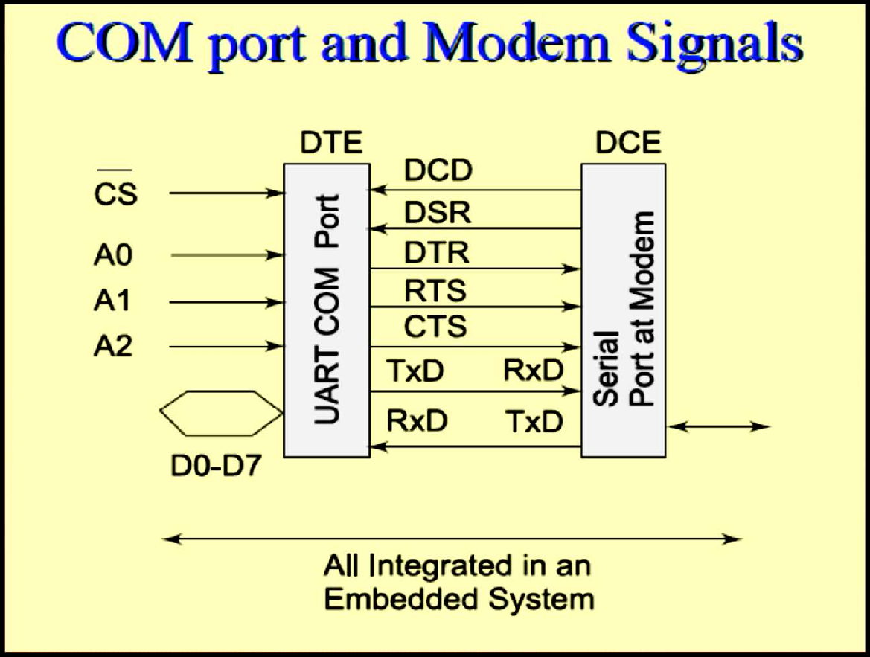
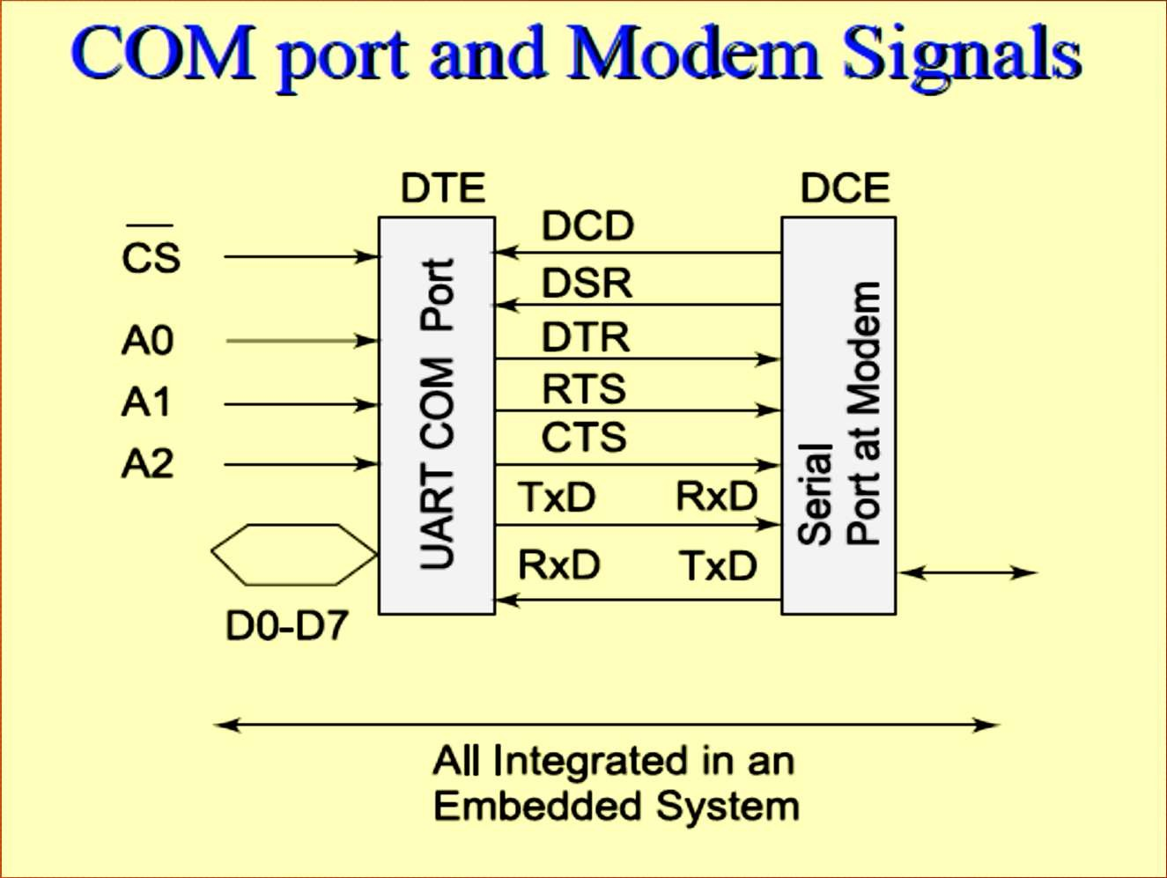
COM Port & Modern Signals

Slide 60
1. Protocol
A protocol is a standard adopted, which tells the way in which the bits of a frame must be sent from a device (or controller or port or processor) to another device or system [Even in personal communication we follow a protocol – we say Hello! Then talk and then say good bye!]
A protocol defines how are the frame bits:
sent-synchronously or Iso-synchronously or asynchronously and at what rate(s)?
preceded by the header bits?
How the receiving device address communicated so that only destined device activates the bits? [Needed when several devices addressed though a common line (bus)]
and receives
How can the transmitting device address defined so that receiving device comes to know the source when receiving data from several sources?
How the frame-length defined so that receiving device know the frame-size in advance?
Frame-content specifications -Are the sent frame bits specify the control or device configuring or commend or data?
Are there succeeding to frame the trailing bits so that receiving device can check the errors, if any in reception before it detects end of the frame ?
Frame bits minimum and maximum length permitted per frame
Line supply and impedances and line-Connectors specifications

Slide 61
Specified protocol at an embedded system port or communication device
I/O port bits sent after first formatted according to a specified protocol, which is to be followed when communicating with another device through an IO port or channel.
Protocols-HDLC, Frame Relay, for synchronous communication
For asynchronous transmission from a device port-RS232C, UART, X.25, ATM, DSL and ADSL
For networking the physical devices in telecommunication and computer networks - Ethernet and token ring protocols used in LAN networks

Slide 62
Protocols in embedded network devices
For Bridges and routers
Internet appliances application protocols and Web protocols
HTTP (hyper text transfer protocol),
HTTPS (hyper text transfer protocol Secure Socket Layer),
SMTP (Simple Mail Transfer Protocol),
POP3 (Post office Protocol version 3), ESMTP (Extended SMTP)

Slide 63
File transfer, Boot Protocols in embedded devices network
TELNET (Tele network),
FTP (file transfer protocol),
DNS (domain network server),
IMAP 4 (Internet Message Exchange Application Protocol) and
Bootp (Bootstrap protocol).

Slide 64
Wireless Protocols in embedded devices network
Embedded wireless appliances uses wireless protocols─ WLAN 802.11, 802.16, Bluetooth, ZigBee, WiFi, WiMax,

Slide 65

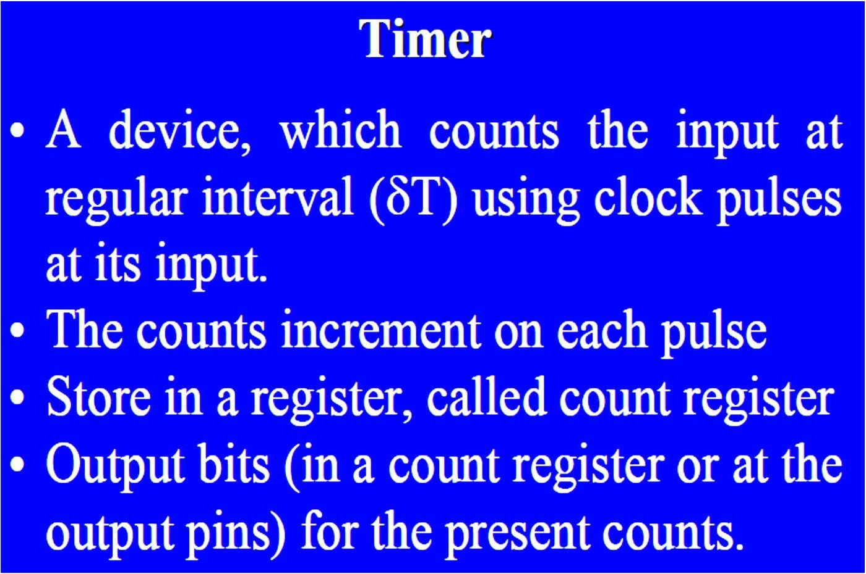
Timer Devices

Slide 66
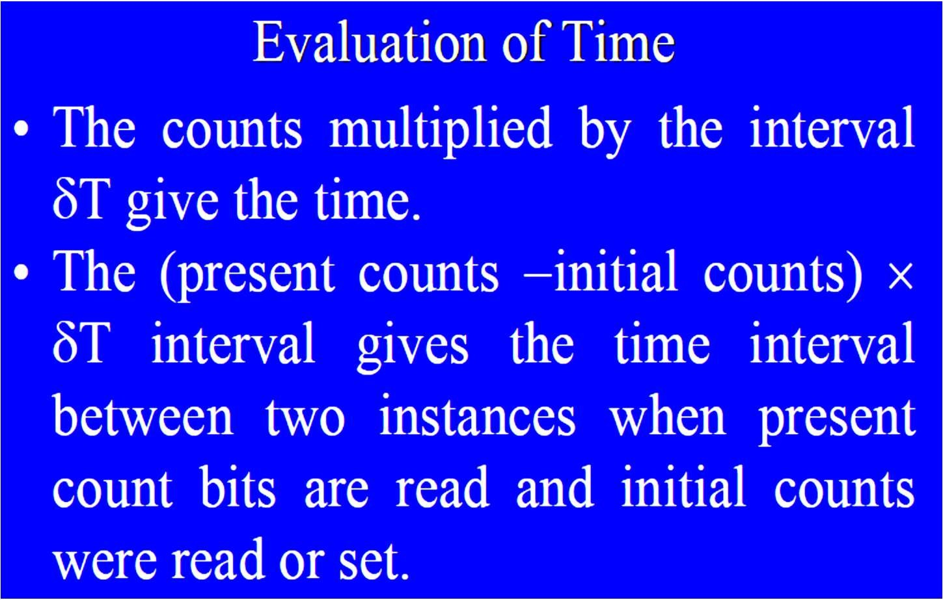

Slide 67
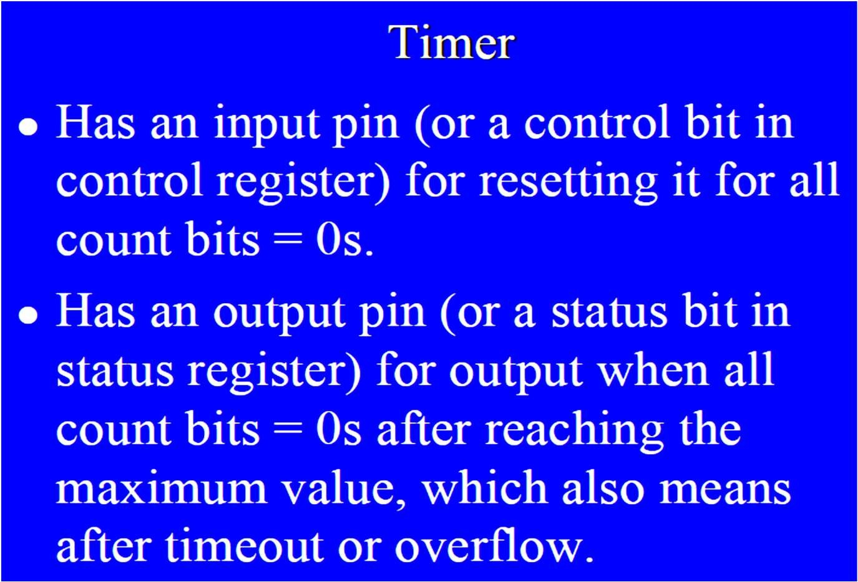

Slide 68
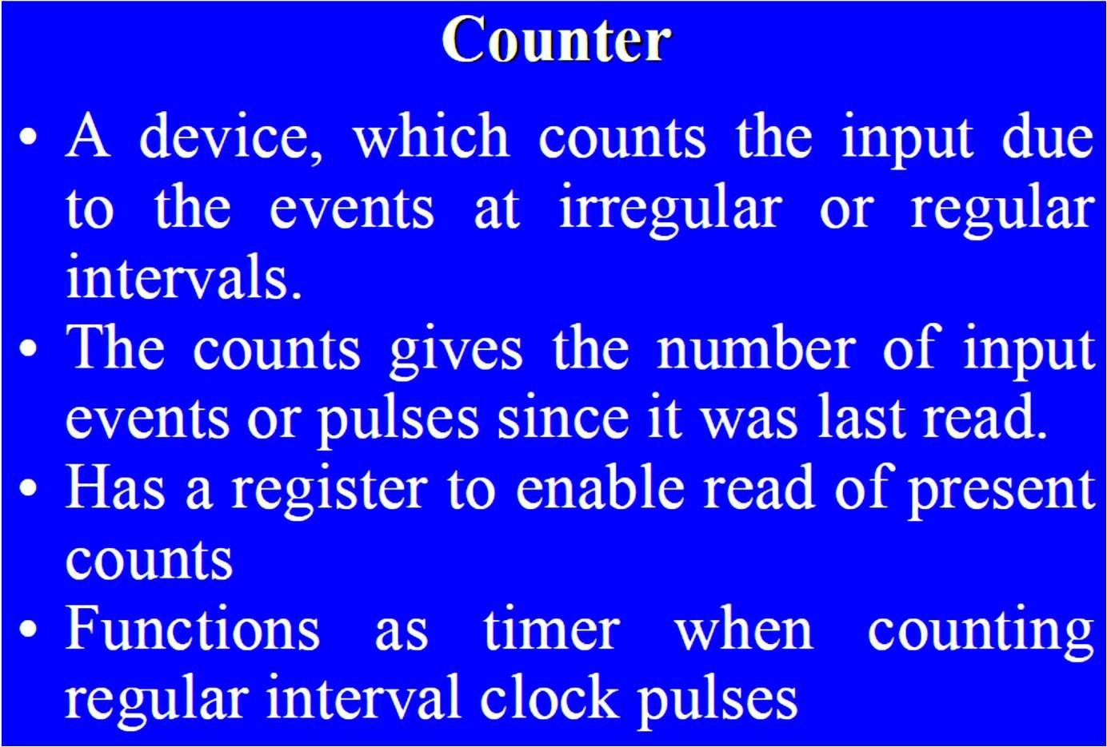
Counter

Slide 69
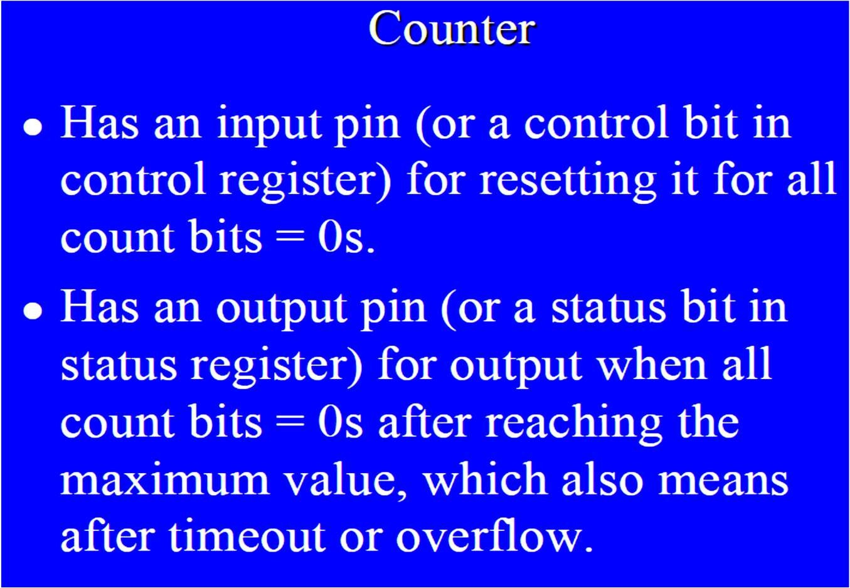

Slide 70
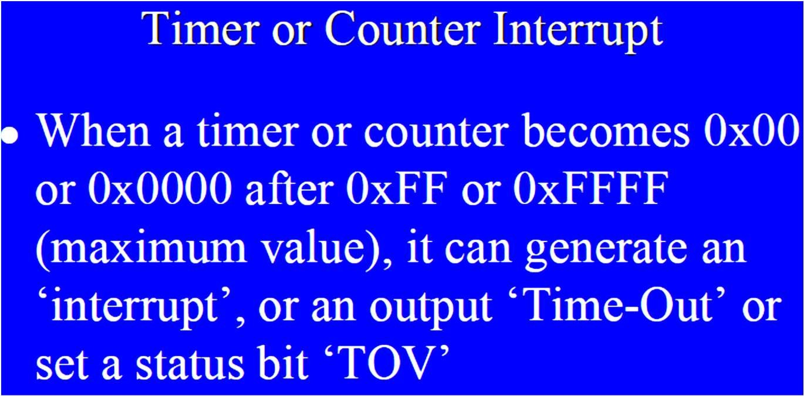
Counting Devices

Slide 71
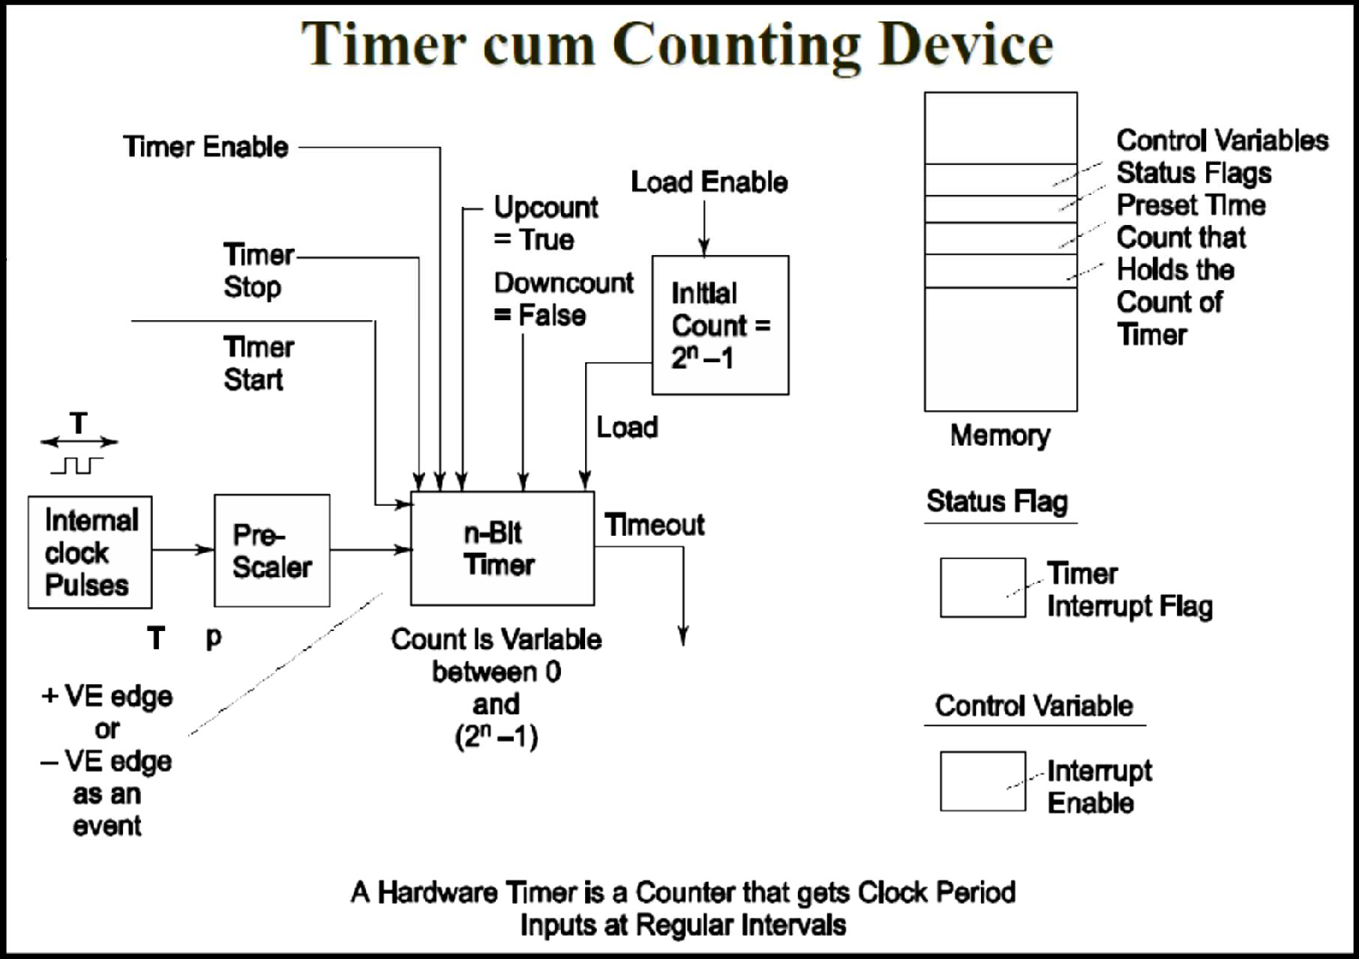
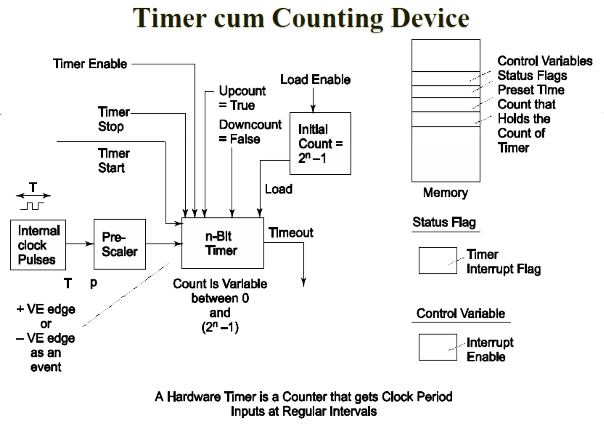

Slide 72
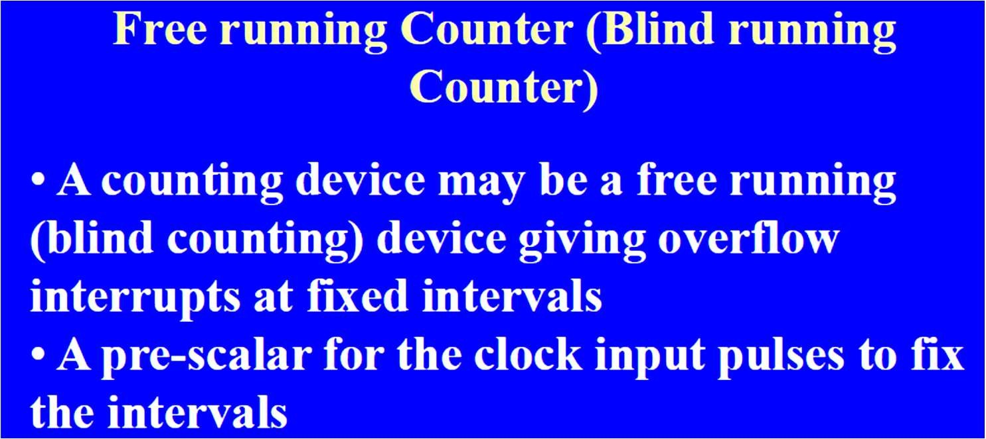

Slide 73
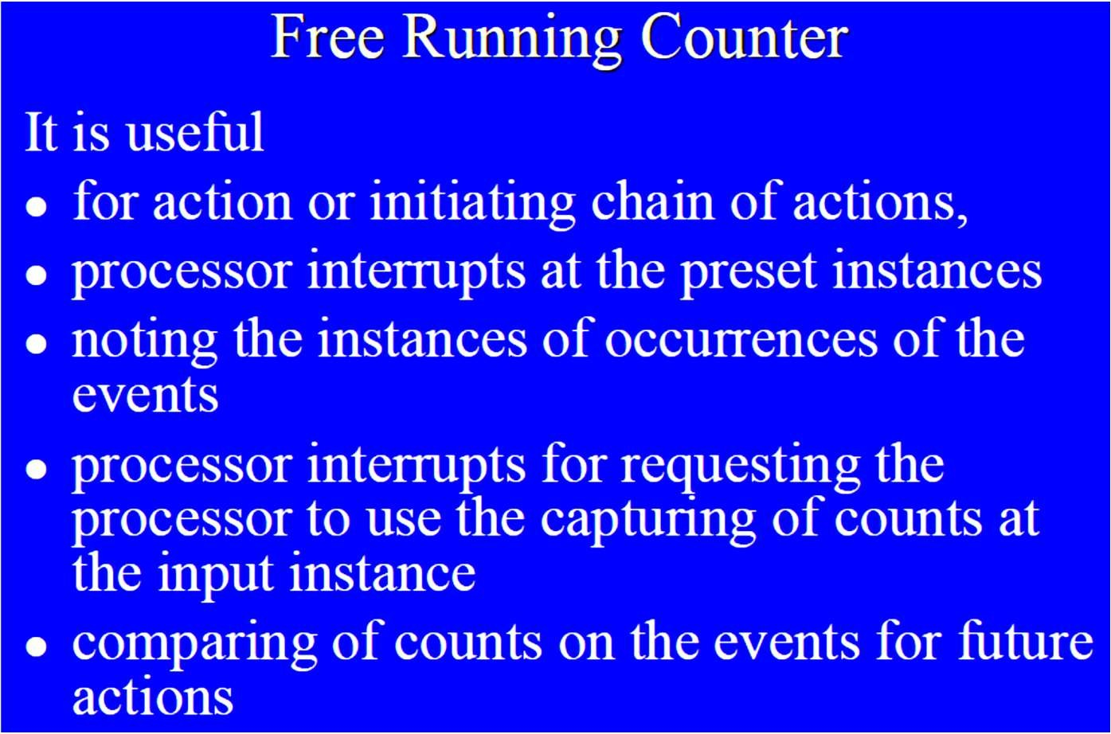

Slide 74
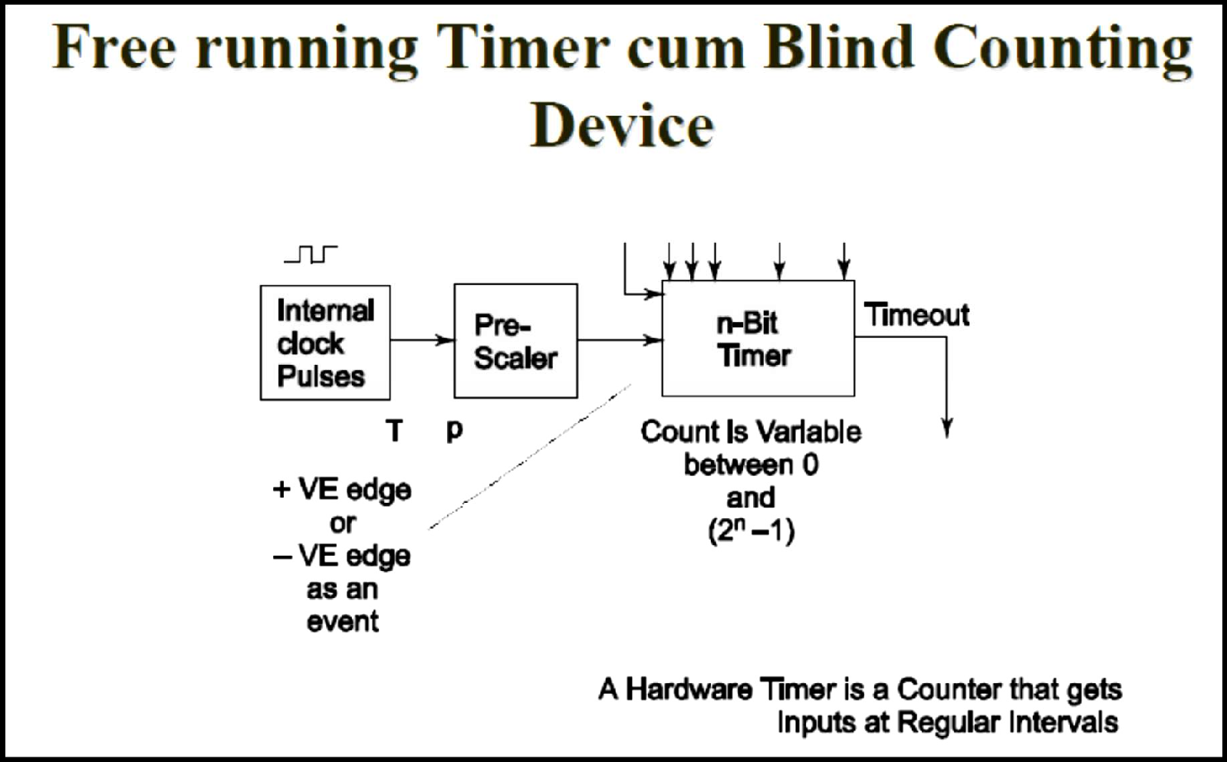
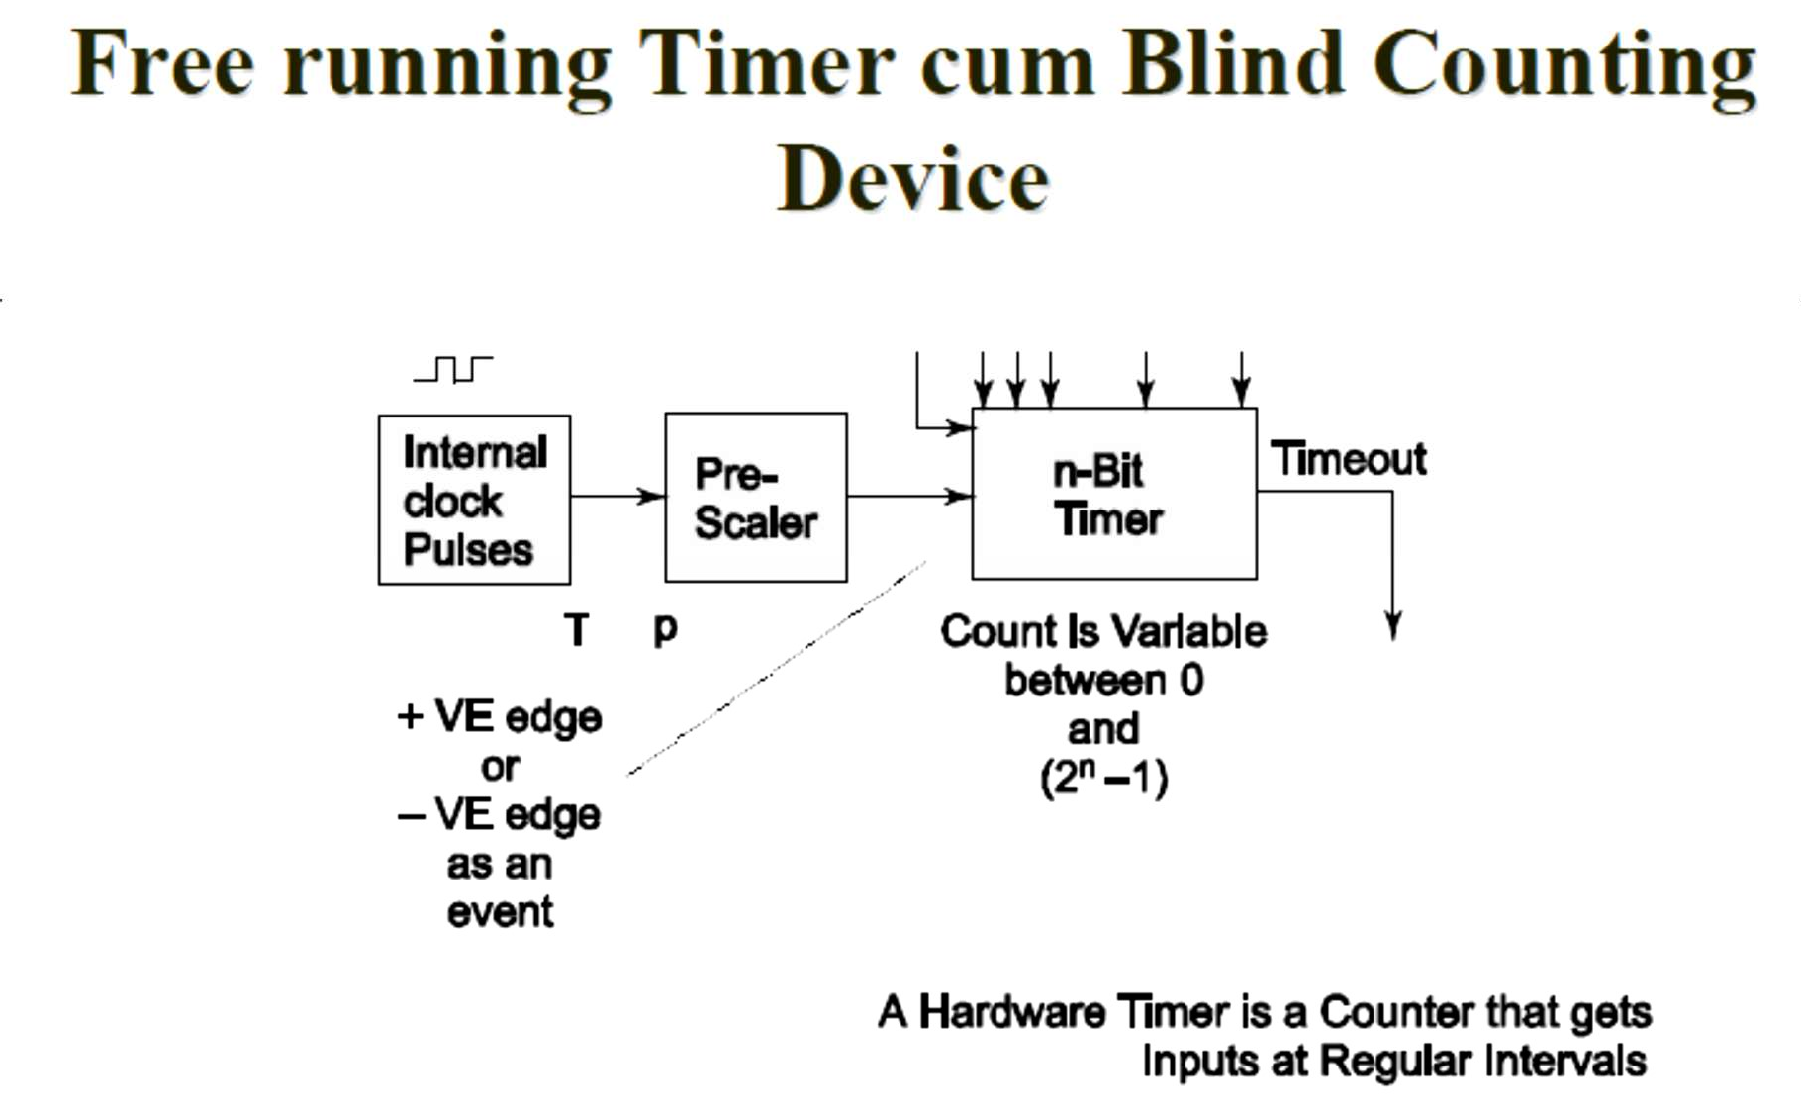

Slide 75
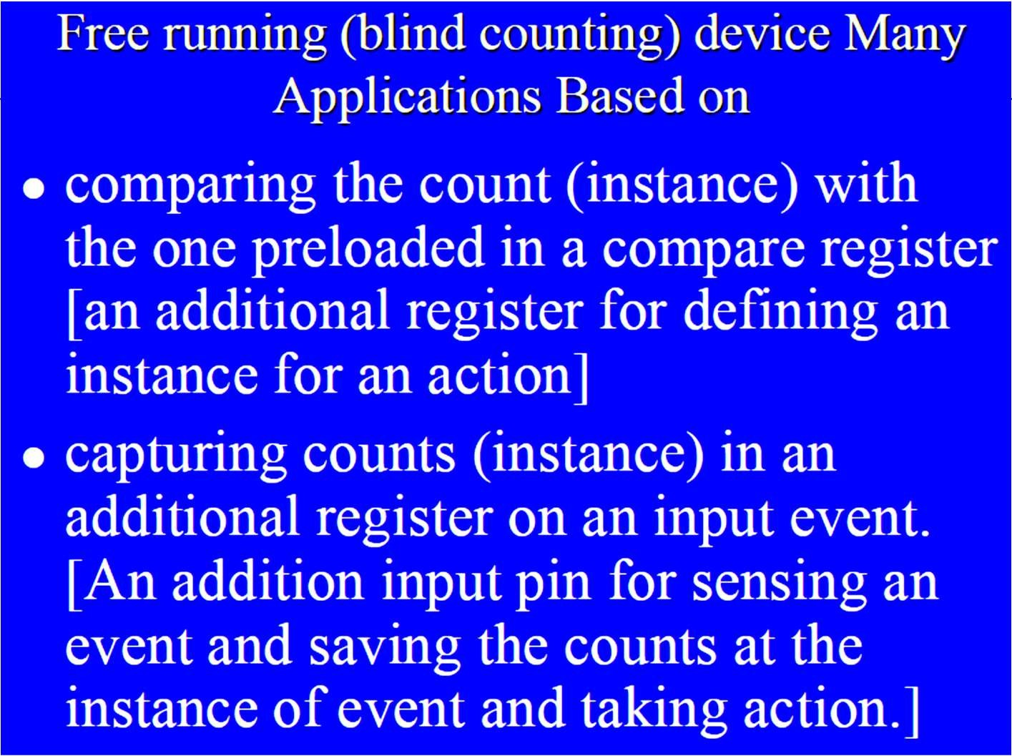
Free Running Counting Devices

Slide 76
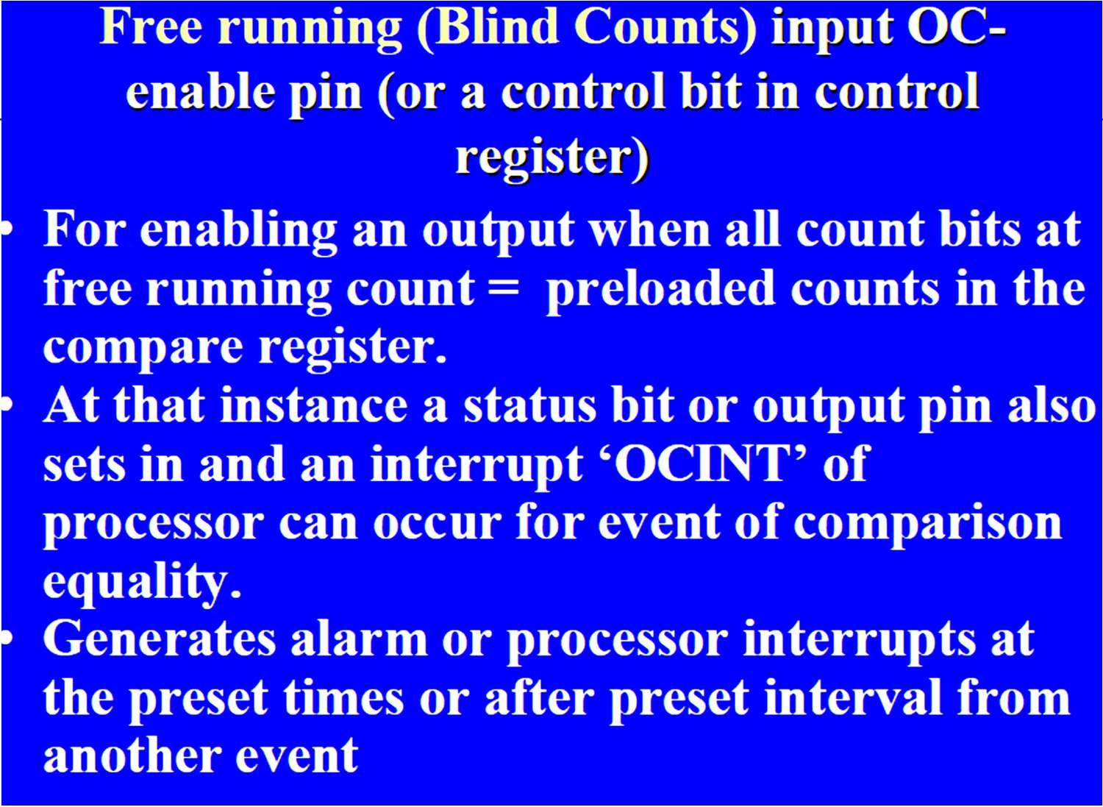

Slide 77
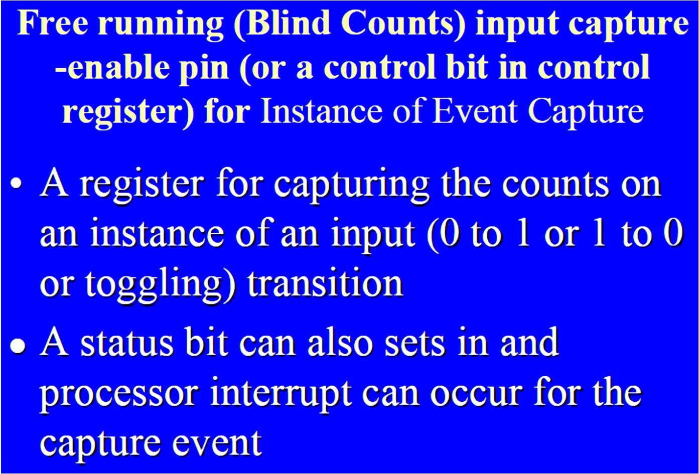

Slide 78
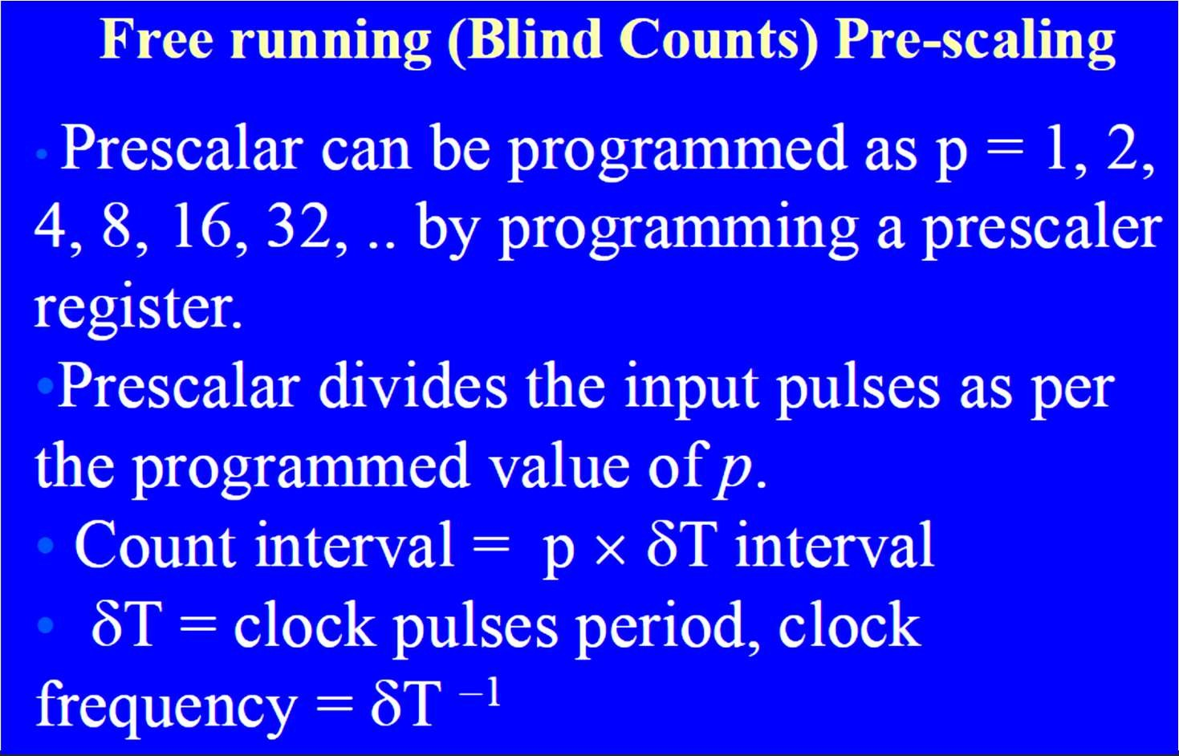

Slide 79
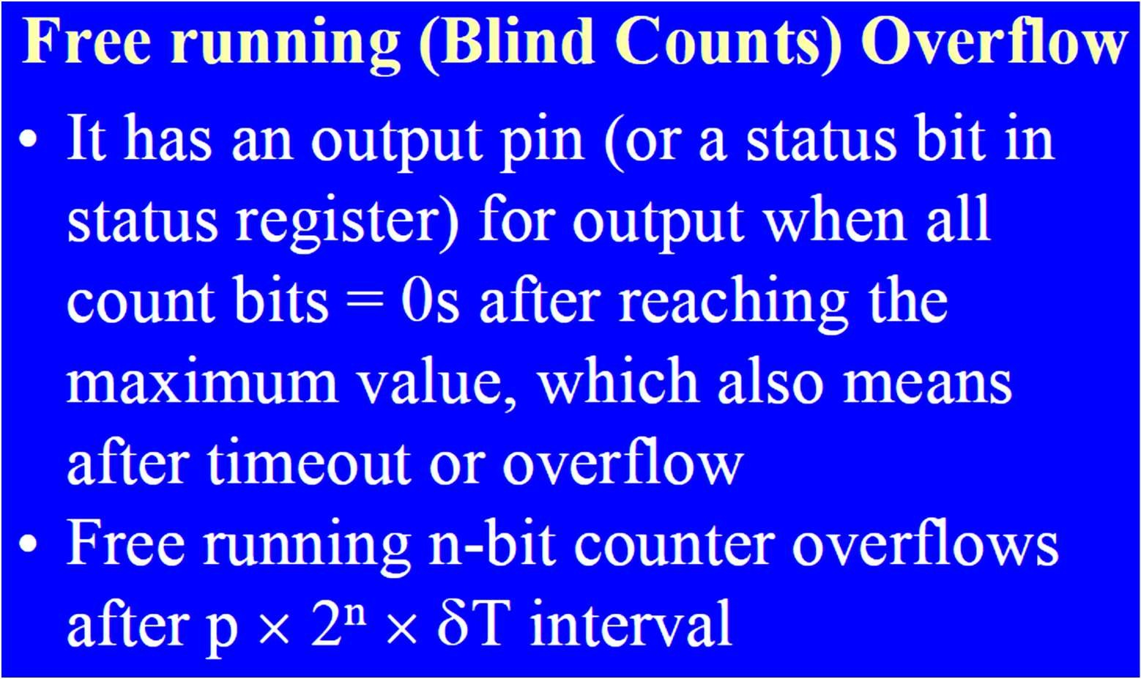

Slide 80
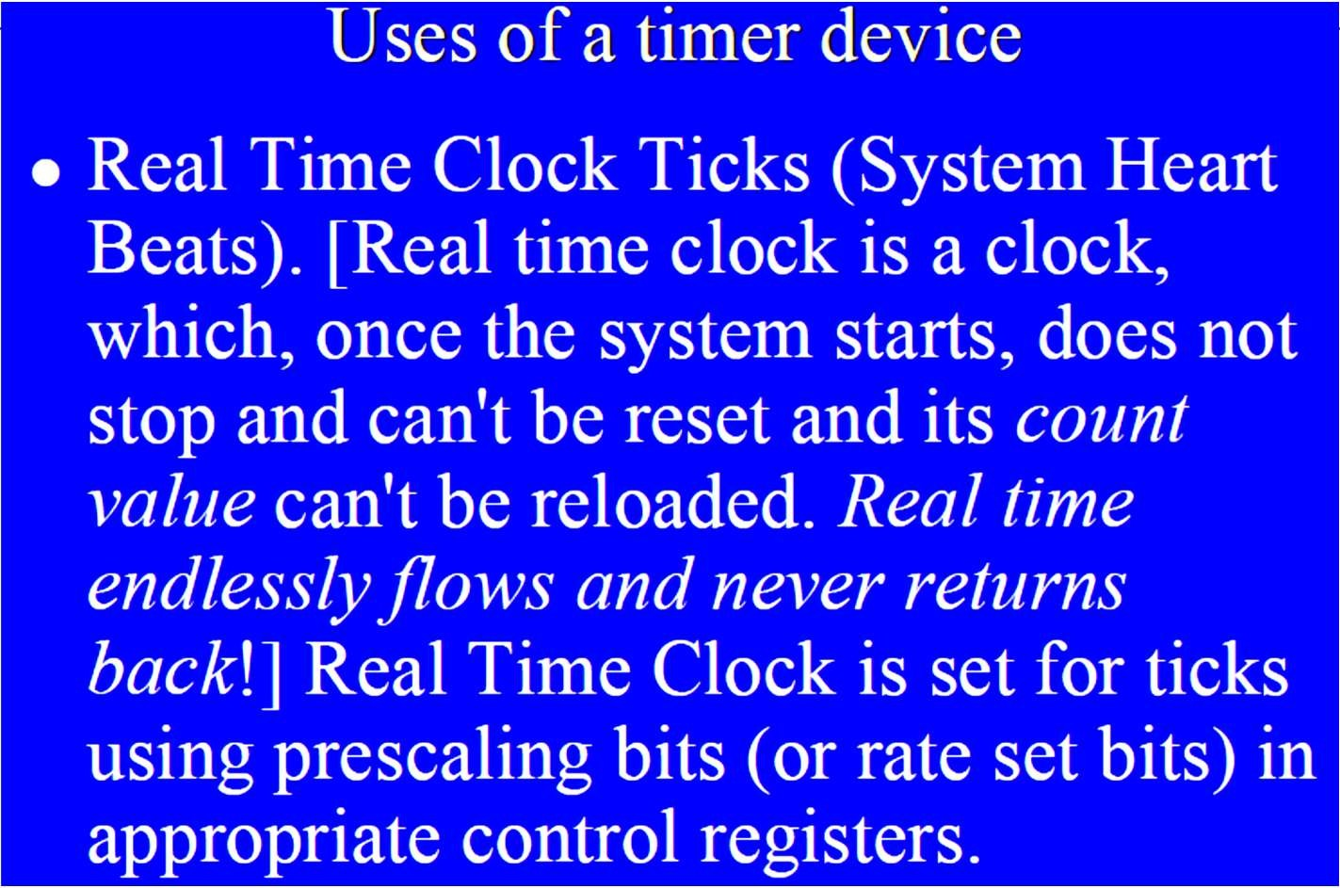
Uses of Timer/Counter Related Devices

Slide 81
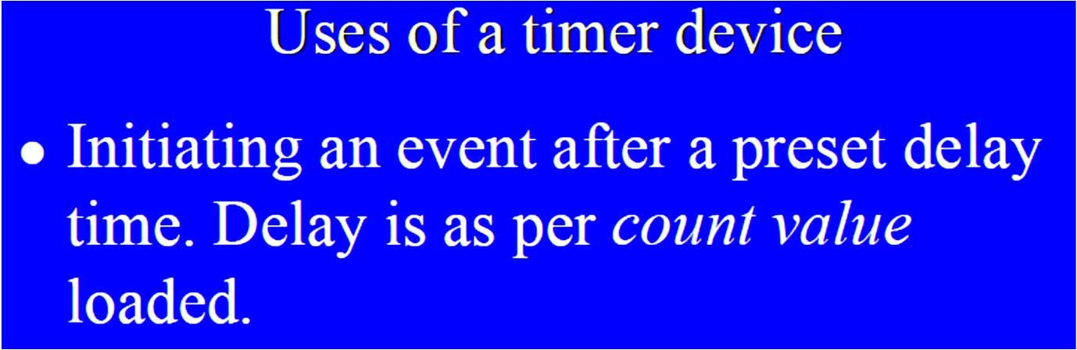

Slide 82
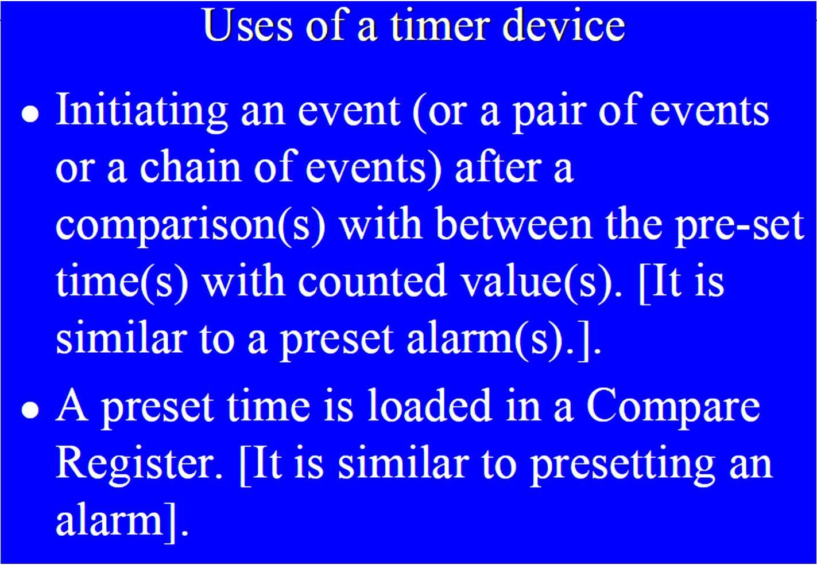

Slide 83
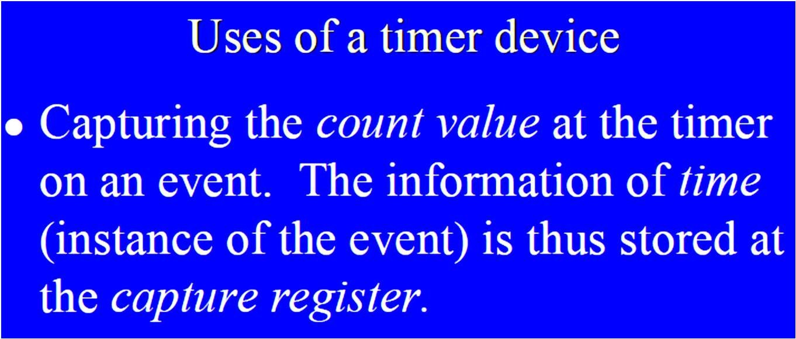

Slide 84
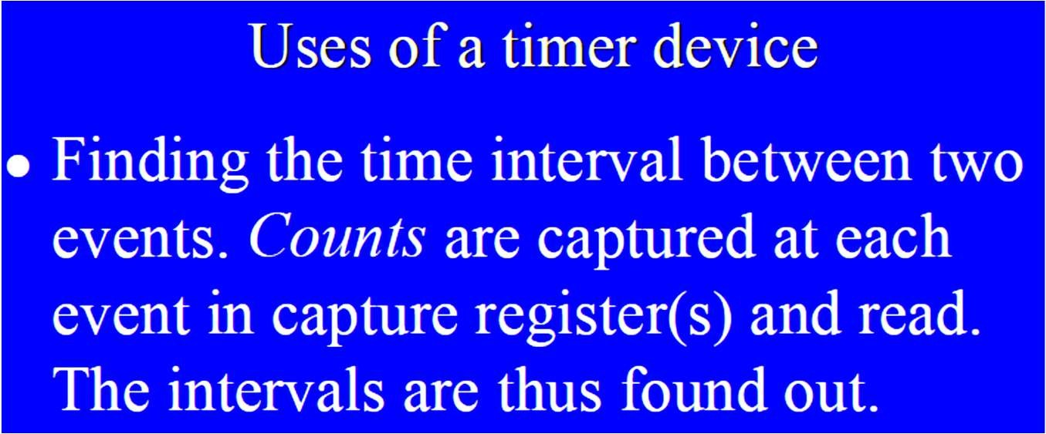

Slide 85
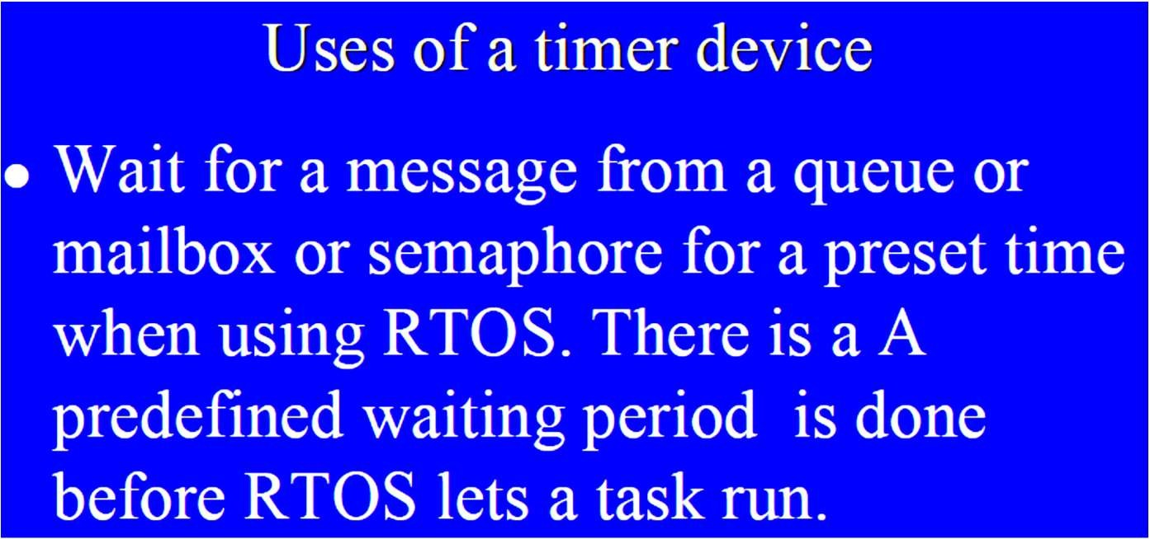

Slide 86


Slide 87


Slide 88


Slide 89


Slide 90


Slide 91


Slide 92


Slide 93


Slide 94

Software Timers

Slide 95

System Clock

Slide 96


Slide 97

Watch Dog Timer

Slide 98


Slide 99


Slide 100


Slide 101


Slide 102

Real Time Clock

Slide 103


Slide 104


Slide 105


Slide 106


Slide 107


Slide 108

Example: Motor Vehicle

Slide 109
End of UNIT-II

